Slide 1

Management Plans Update
Phoenix AMA GUAC Meeting
February 4, 2021
Maggie Martin
Management Plans Specialist

Slide 2

Fourth Management Plans

Slide 3
4MP Adoption Timeline
1. Initial Draft Published
2. GUAC and Public Comments
3. Updated Draft Published
4. Public Hearing
5. Final Adoption
Phoenix AMA
Santa Cruz AMA
Pinal AMA
Programs Effective 1/1/2023
Final Adoption (est Summer 2021)
Programs Effective 1/1/2024
Final Adoption (est Winter 2020)
Final Adoption (est Summer 2020)
Programs Effective 1/1/2023
  Final Adoption: Spring 2020
  Programs Effective: January 2023
  Final Adoption:
  Fall 2020
  Programs Effective: January 2023
  Final Adoption:
  Winter 2020
  Programs Effective: January 2023
Conservation Program Requirements go into effect at least 2 years after a plan is adopted.
ADWR shifts the actual effective date past the 2 year mark to line up with Reporting Years.

Slide 4
Fifth Management Plans

Slide 5
Estimated 5MP Timeline new.azwater.gov/5MP
MPWG
Program Analysis
Program Development
Drafting
Document Structure & Content
Promulgation
Present to GUACs and stakeholders
Conservation Programs become effective 1/1/2025
Implementation & Strategy
2020
2021
2022
Notes:
Structure: Chapters, level of detail, projections

Slide 6
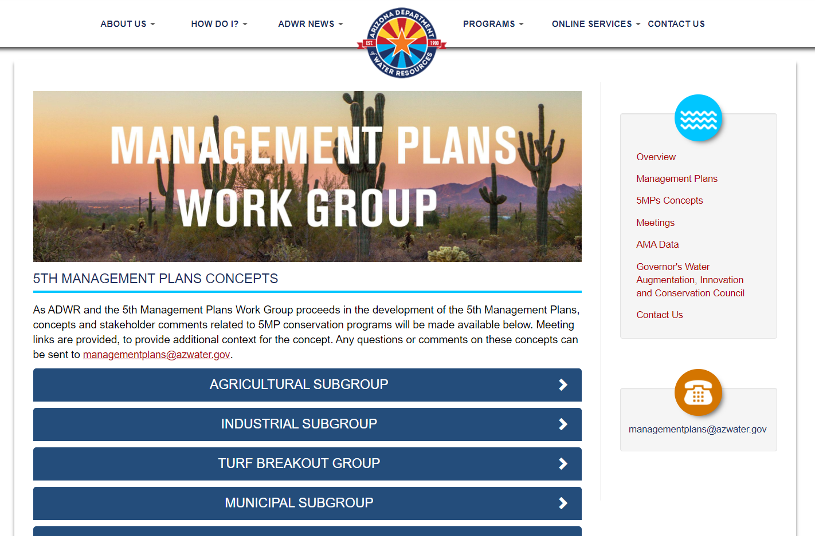
5MP Concepts Webpage
https://new.azwater.gov/5MP/plans-concepts
Notes:
Remove?

Slide 7
Drafting Logistics
All 5 Fifth Management Plans will be drafted simultaneously
  Structure will largely match across AMAs
  Time for AMA Customization
MPWG Subgroups will reconvene as needed to review draft regulatory language
Goal: Publication of Initial Drafts in early 2022

Slide 8

MPWG Subgroups
{ All meeting info is available at new.azwater.gov/5MP }
MPWG
Ag
Industrial
Turf
Work Group
Subgroup
Breakout
Muni
Safe-Yield Technical
TBD
3/24/2021
2/10/2021
TBD
3/10/2021
2/24/2021

Slide 9
Questions?
Maggie Martin
mmartin@azwater.gov
Management Plans Work Group:
new.azwater.gov/5MP
Concepts page: https://new.azwater.gov/5MP/plans-concepts
Full Text of Management Plans:
new.azwater.gov/ama/management-plans
For questions about meetings or to submit comments:
managementplans@azwater.gov

