Slide 1
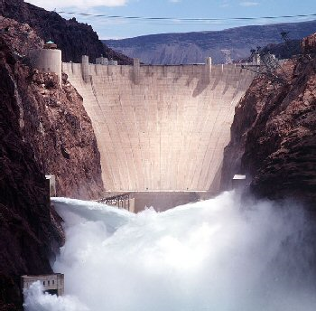
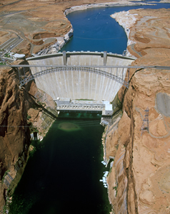
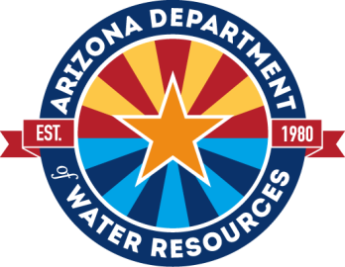
COLORADO RIVER BASIN
UPDATE AND STATUS
Presented to:
Phoenix
Groundwater Users Advisory Council
February 4, 2021

Slide 2
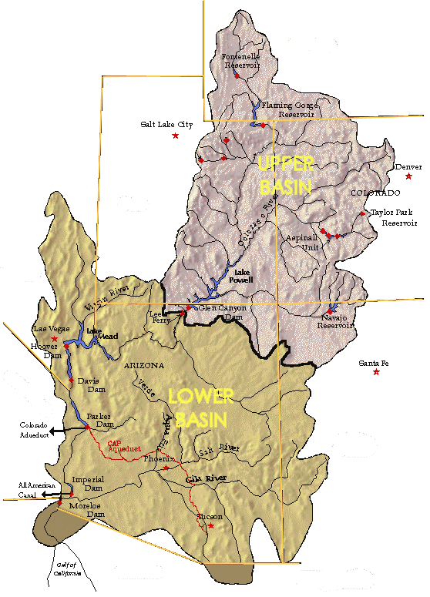
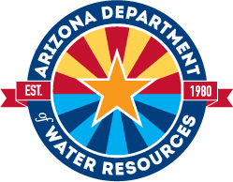
COLORADO RIVER SYSTEM
RESERVOIR STATUS
44%
WYOMING
Fontenelle
84%
TOTAL SYSTEM CONTENTS – 45% or 27.303 MAF
Flaming Gorge
February 2021
Updated as of February 1, 2021
UTAH
Lake Powell
COLORADO
3,659 ft, WY 2021 Equalization Level
40% 9.625 MAF
48%
3,576.29 ft
91%
Blue Mesa
NEVADA
Lake Mead
Morrow Point
40% 10.524 MAF
63%
%
1,086.11 ft
ARIZONA
Navajo
1,075 ft. Tier One Shortage
NEW MEXICO
Reservoir Storage (MAF) - As of February 1, 2021
Reservoir | Current | Storage Last Year | Maximum
Lake Mead | 10.524 | 12.274 | 26.120
Lake Powell | 9.625 | 12.773 | 24.322
Fontenelle | 0.153 | 0.176 | 0.345
Flaming Gorge | 3.150 | 3.270 | 3.749
Blue Mesa | 0.400 | 0.554 | 0.830
Morrow Point | 0.106 | 0.107 | 0.117
Navajo | 1.060 | 1.310 | 1.696
CALIFORNIA
Data Source: United States Bureau of Reclamation

Slide 3
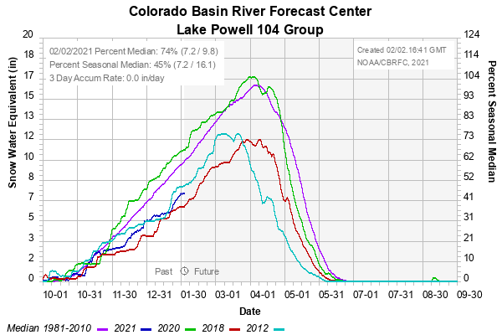
Snow Water Equivalent
Snowpack as of February 2, 2021

Slide 4
Lake Powell and Lake Mead
Operational Diagram and Current Conditions
3,576.29’ as of 2/1/21
3,563.97’ 9/30/21 (est.)
1,086.11’ as of 2/1/21
1,069.75’ 12/31/21 (est.)

Slide 5
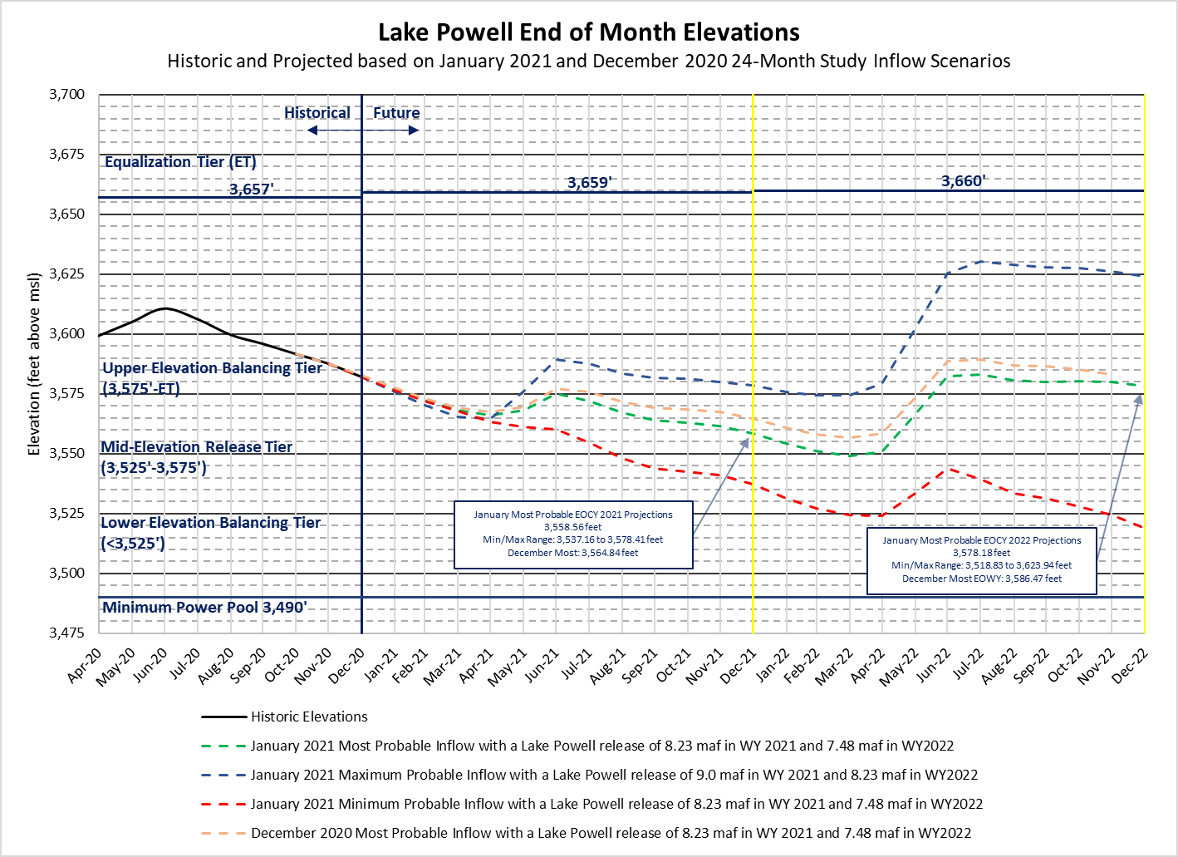
Colorado River System

Slide 6
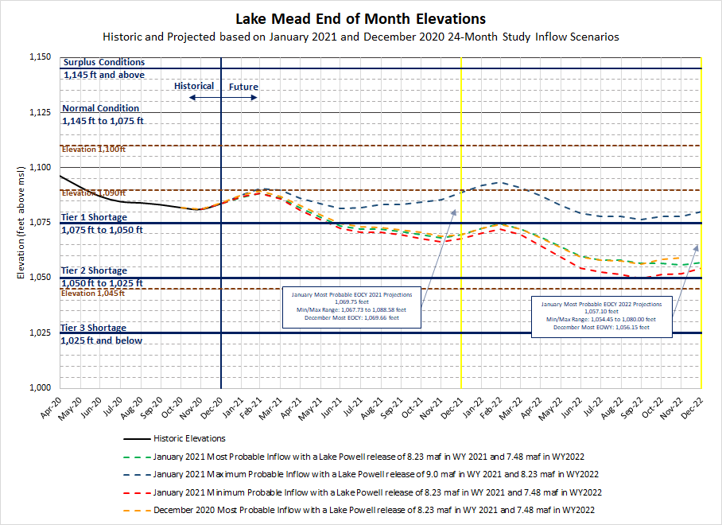
Colorado River System

Slide 7
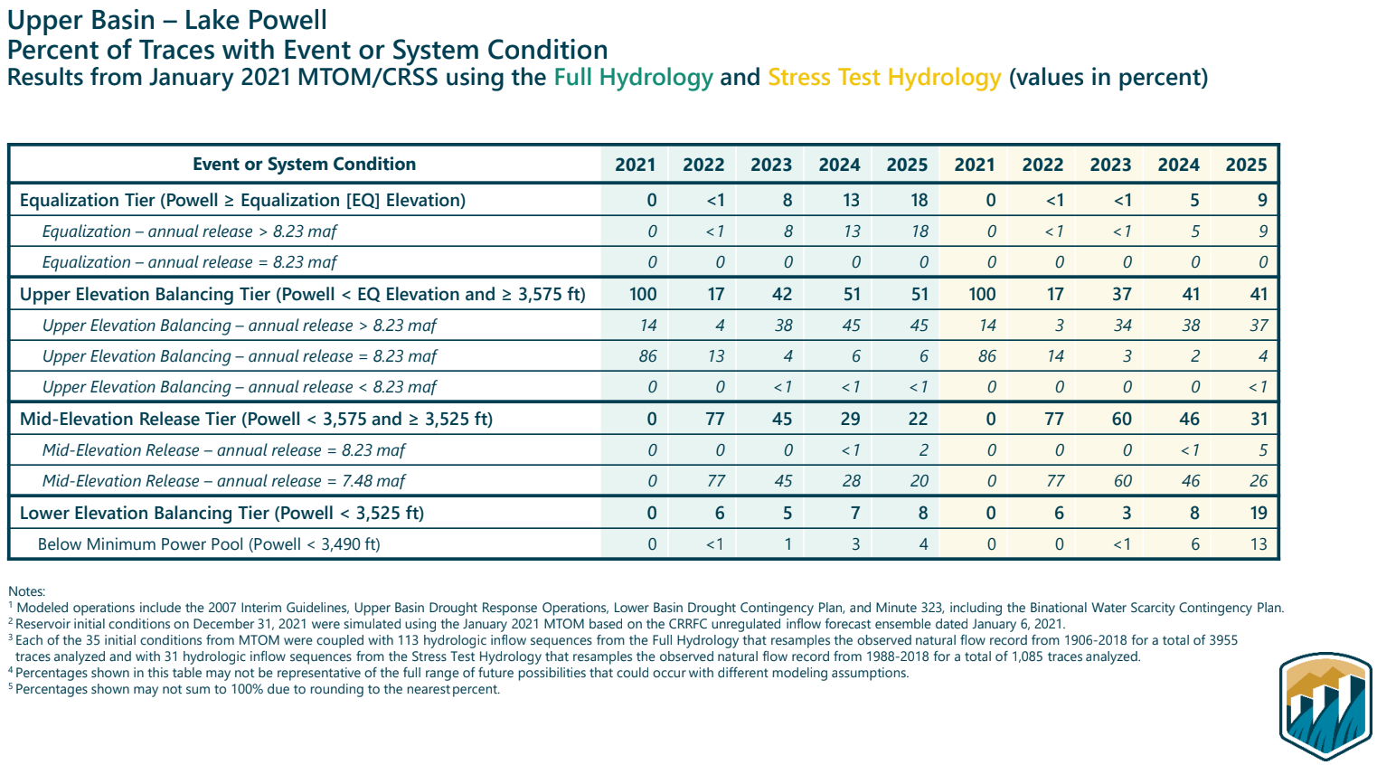
CRSS 5 Year Probability Table

Slide 8
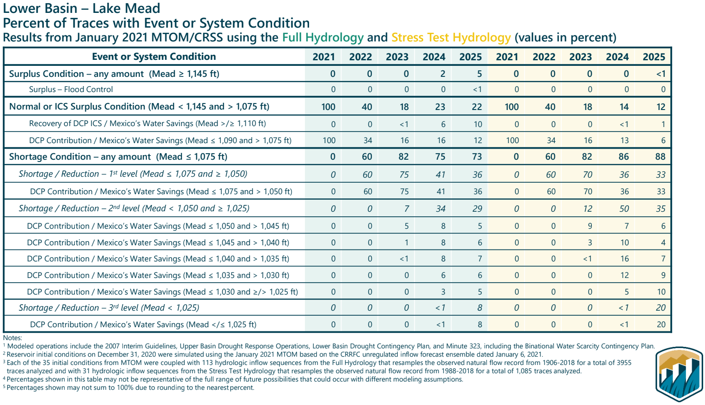
CRSS 5 Year Probability Table

Slide 9
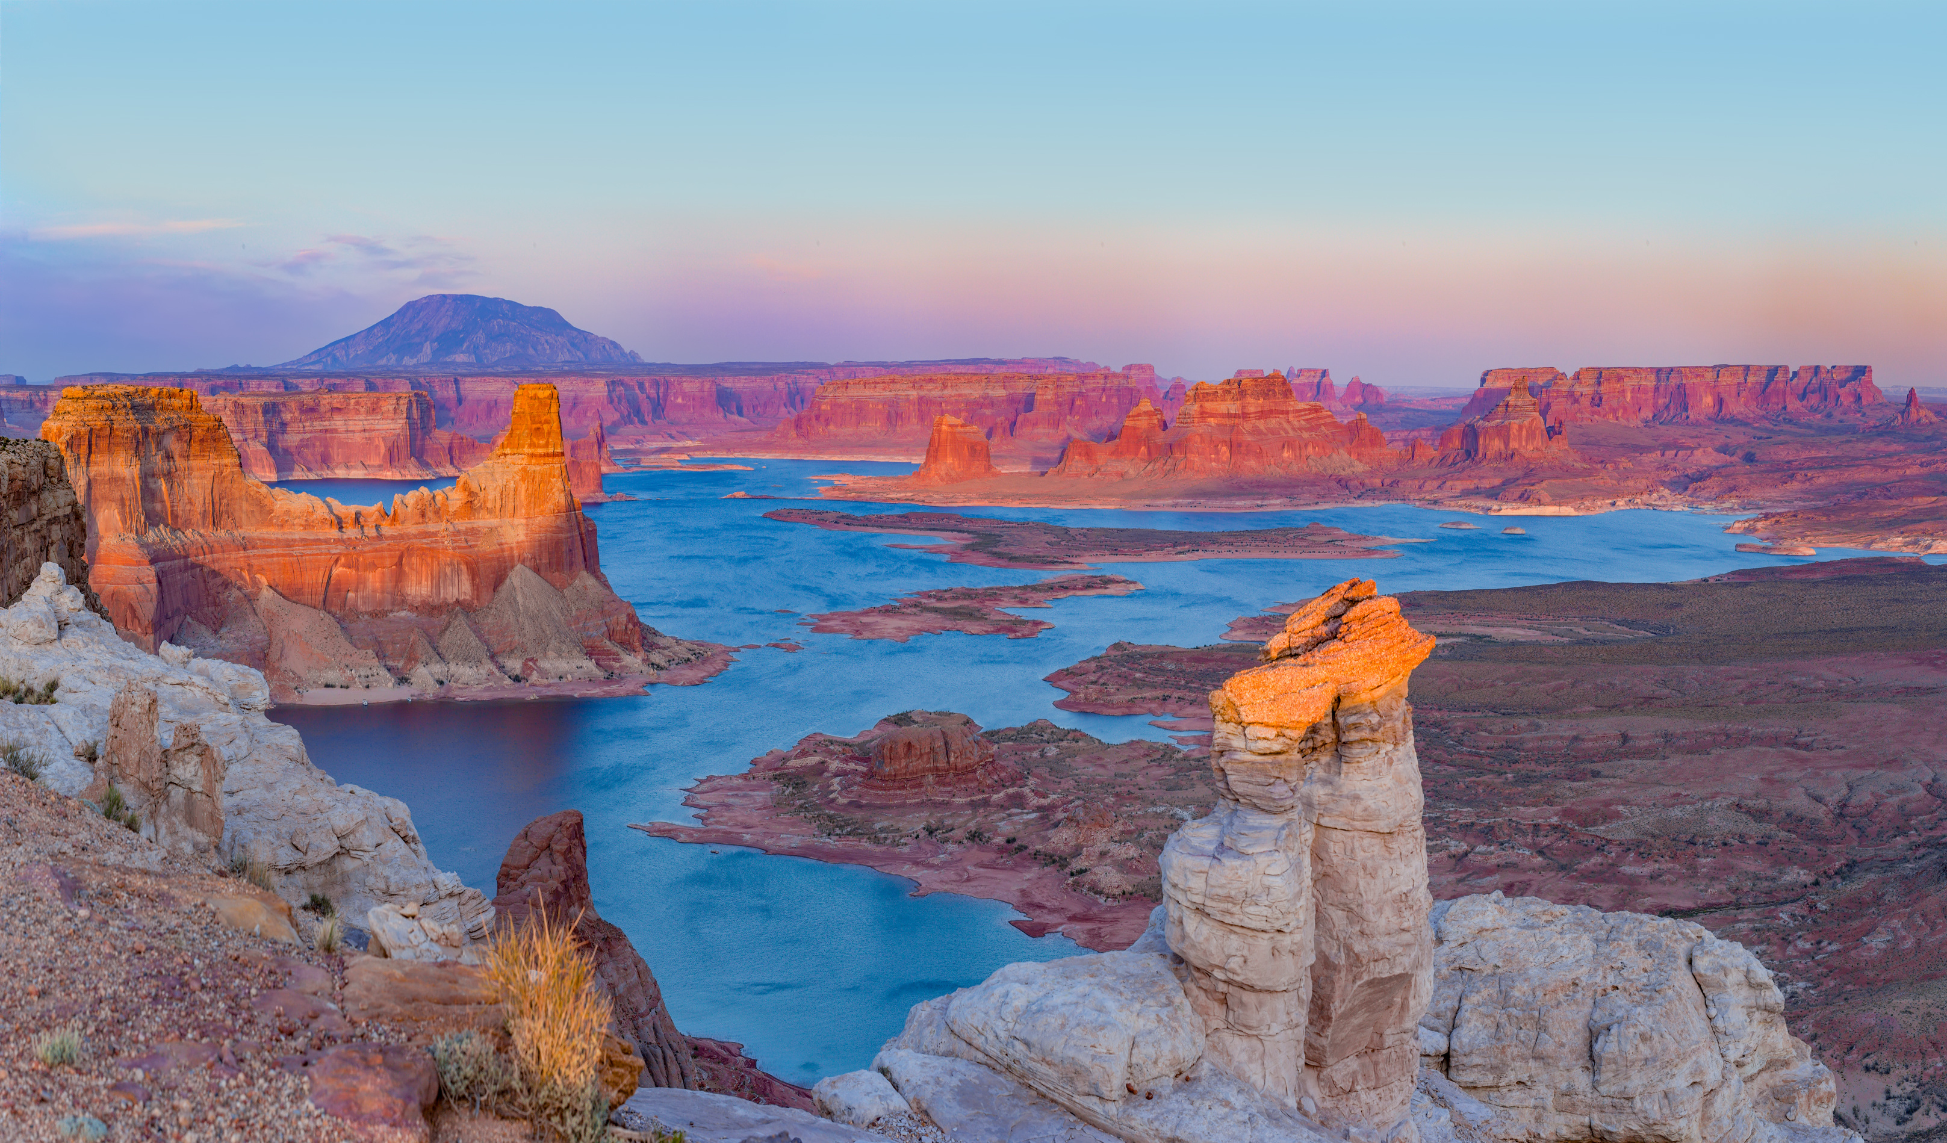
Questions?
Craig McGinnis
cmcginnis@azwater.gov

