Slide 1

Farm Filled Ag-Ventures

Slide 2

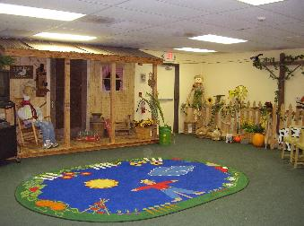
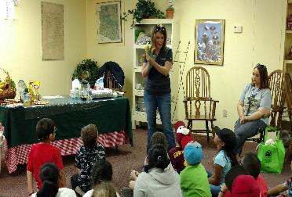
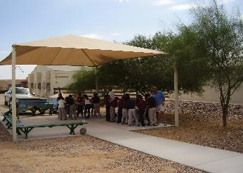
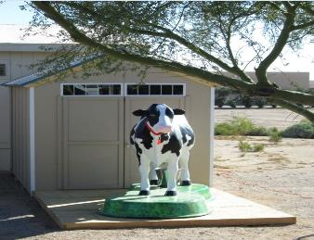
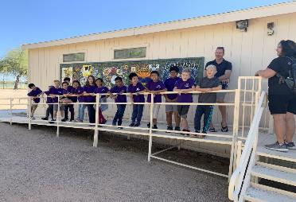
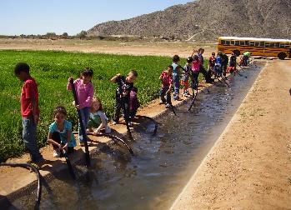
Natural Resource Education Center
at Central Arizona College
Signal Peak Campus

Slide 3

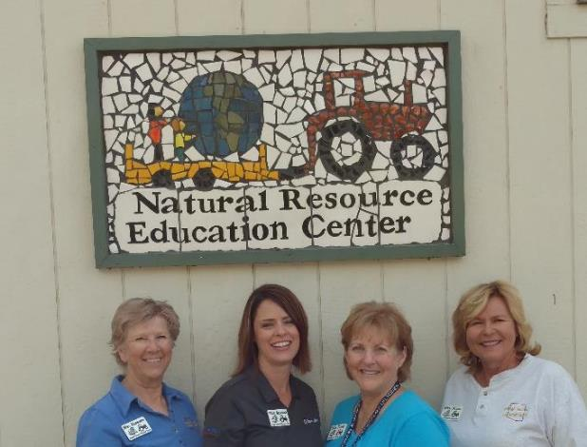
NREC Staff
Jennifer Salcido
Director
Teaching Team:
Jan Zapata
Loralee Wuertz
Carolyn Harbison

Slide 4

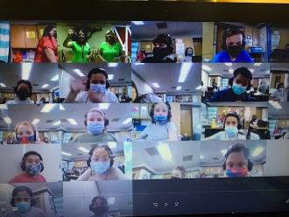
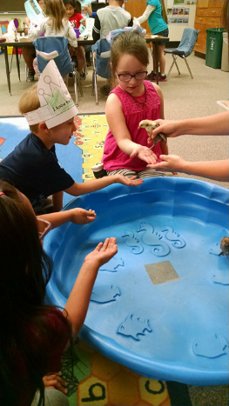
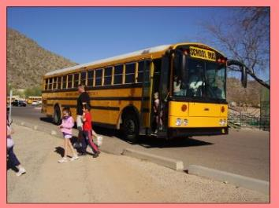
Natural Resource Education Center Programs
On-line presentations
Classroom Visits
Field Trips

Slide 5

NREC PROGRAMS
6 “Farm Filled Ag-Ventures” programs are offered each year:
  Veggie Ventures
  Water out West (WOW)
  Ag-Ventures Corn Festival
  From Alfalfa to Ice Cream
  The Five C’s of Arizona
  Let’s get crackin’ egg program

Slide 6


NREC is sponsored by three (3)
Natural Resource Conservation Districts
~Eloy Natural Resource Conservation District~
~Florence-Coolidge Natural Resource Conservation District~
~West Pinal Natural Resource Conservation District~
NREC is over seen by the Arizona State Land Department

Slide 7





Grants
Arizona Department of Water Resources
Central Arizona Project
Salt River Project
John F. Long Foundation
Pinal 40

Slide 8

WATER OUT WEST
curriculum for K-5th graders
Az State Educational Standards
STEM
Builds on information they learned during 4th grade, Project Wet
Unique program throughout Arizona

Slide 9

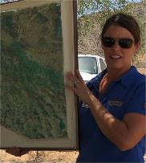
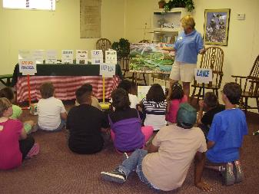
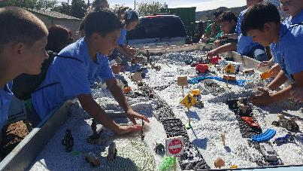
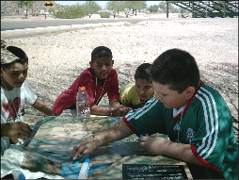
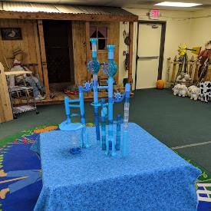
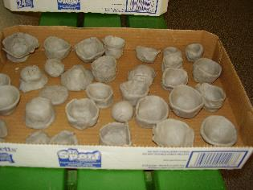
Water cycle
Rolling Rivers
Water sheds
Water movement/management
NEW
irrigation
Water history/conservation

Slide 10

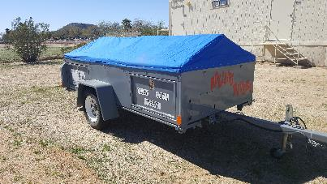
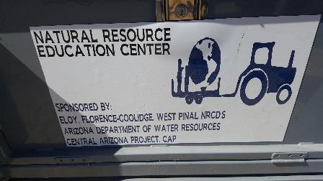
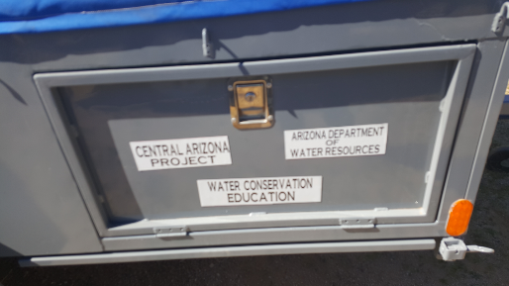
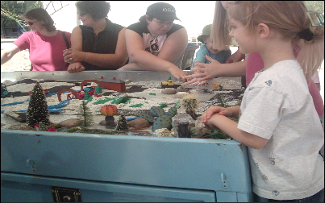
Rolling Rivers
Mobile Trailers
Water Out West
(WOW)

Slide 11

Other expenses
Resource materials
Classroom supplies
Office supplies
Classroom lease
Internet WiFi
Accountant

Slide 12


2021-2022
Restart In classroom visits/field trips
Continue On-line videos presentations
material kits for classroom follow-up/support

Slide 13

Thank you
Arizona Department of Water Resources
for your continued generous support
of the
Natural Resource Education Center

