Slide 1
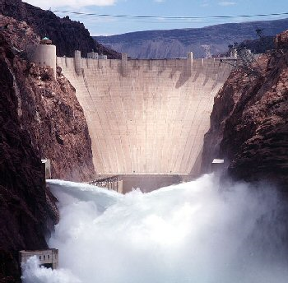
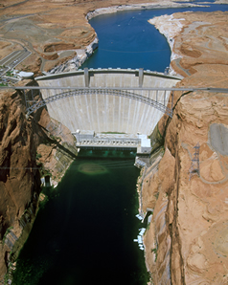
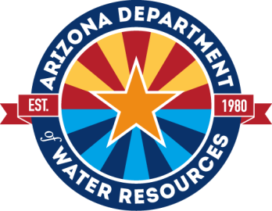
COLORADO RIVER BASIN
STATUS UPDATE
Presented to:
Groundwater Users Advisory Council
Pinal Active Management Area
June 1, 2021

Slide 2
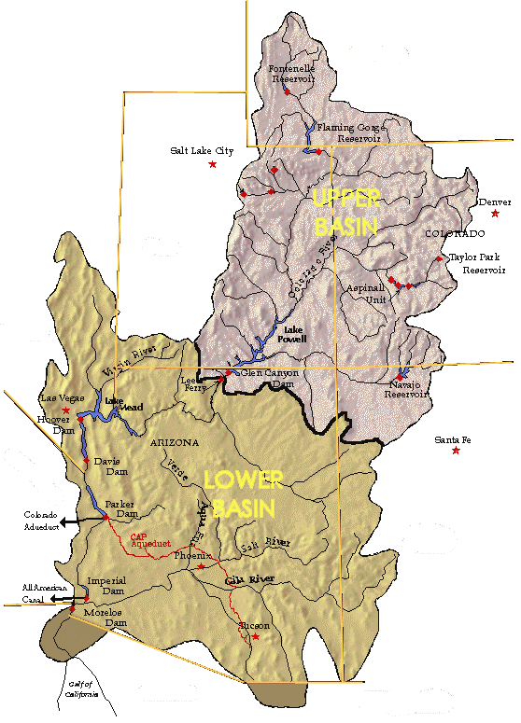
COLORADO RIVER SYSTEM
RESERVOIR STATUS
37%
Fontenelle
WYOMING
85%
Flaming Gorge
TOTAL SYSTEM CONTENTS – 41% or 25.114 MAF
(Total system contents last year 50% or 30.841 MAF)
May 2021
Updated as of May 20, 2021
UTAH
Lake Powell
COLORADO
3,659 ft, WY 2021 Equalization Level
34% 8.34 MAF
41%
Blue Mesa
3,560.26 ft
NEVADA
94%
Lake Mead
Morrow Point
37% 9.67 MAF
63%
Navajo
1,075.86 ft
ARIZONA
1,075 ft, First Tier Shortage
NEW MEXICO
CALIFORNIA
Data Source: United States Bureau of Reclamation

Slide 3
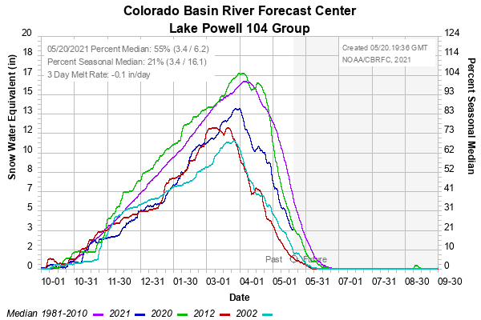
Snow Water Equivalent
Conditions as of May 20, 2021
Peak March 30
89% of Median

Slide 4
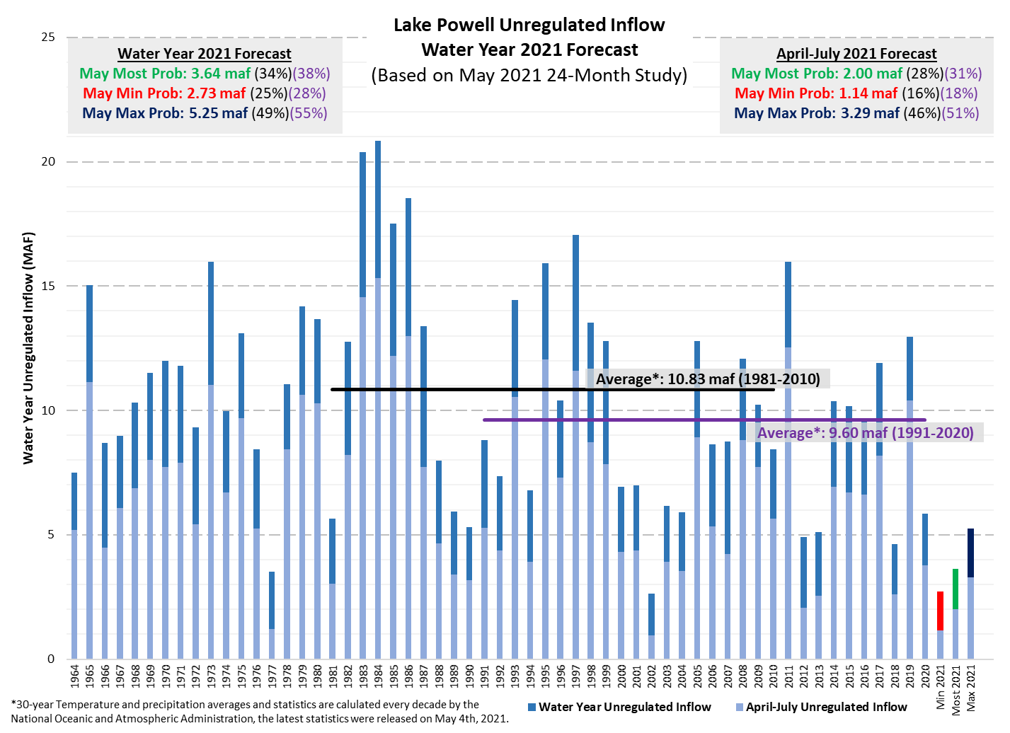

Slide 5
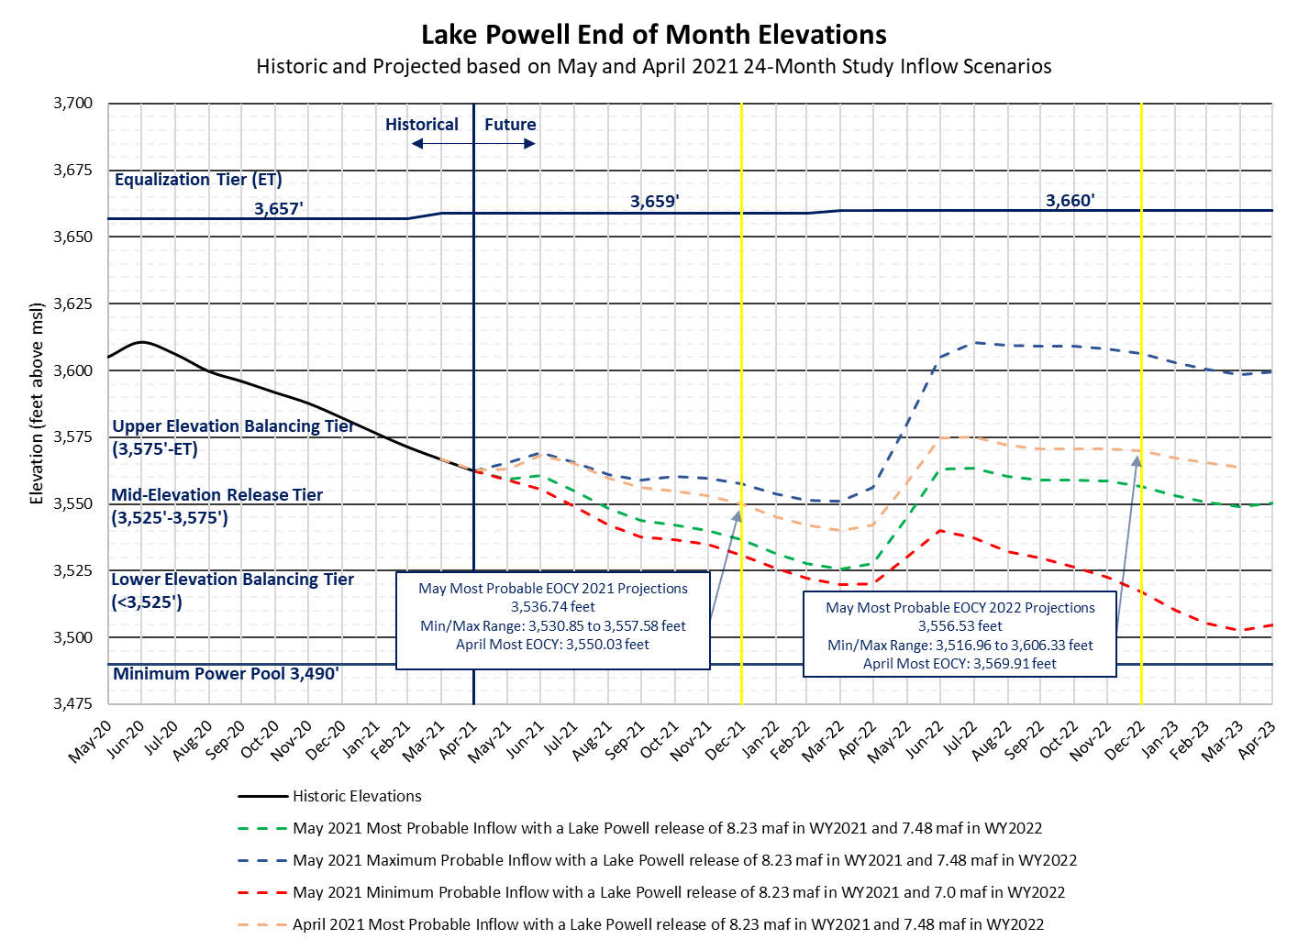

Slide 6
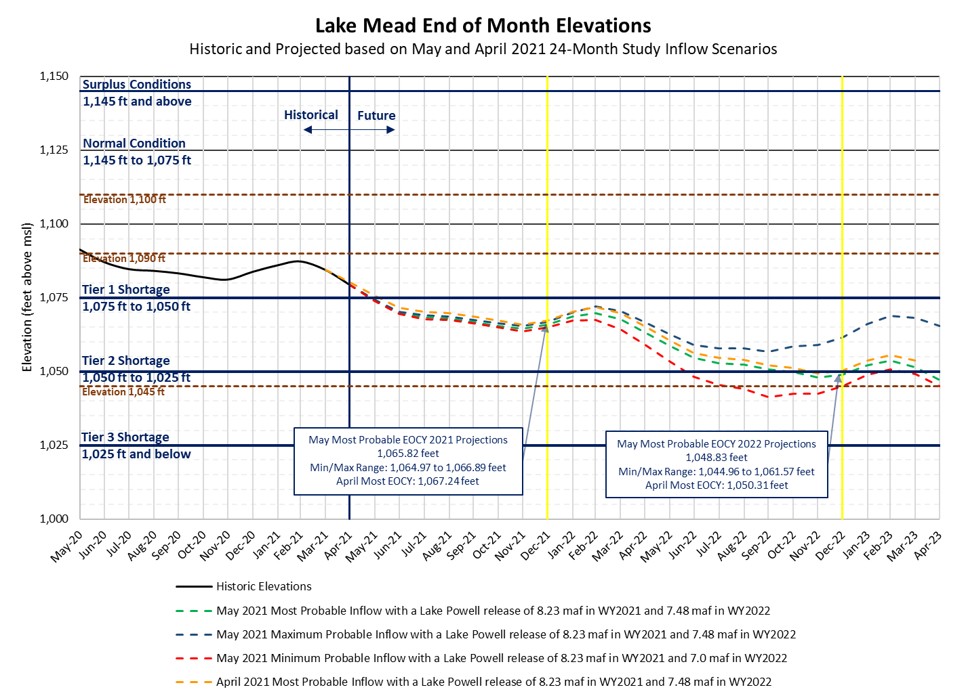

Slide 7
Lower Basin Side Inflows – WY/CY 2021^{1,2}
Intervening Flow from Glen Canyon to Hoover Dam

Slide 8
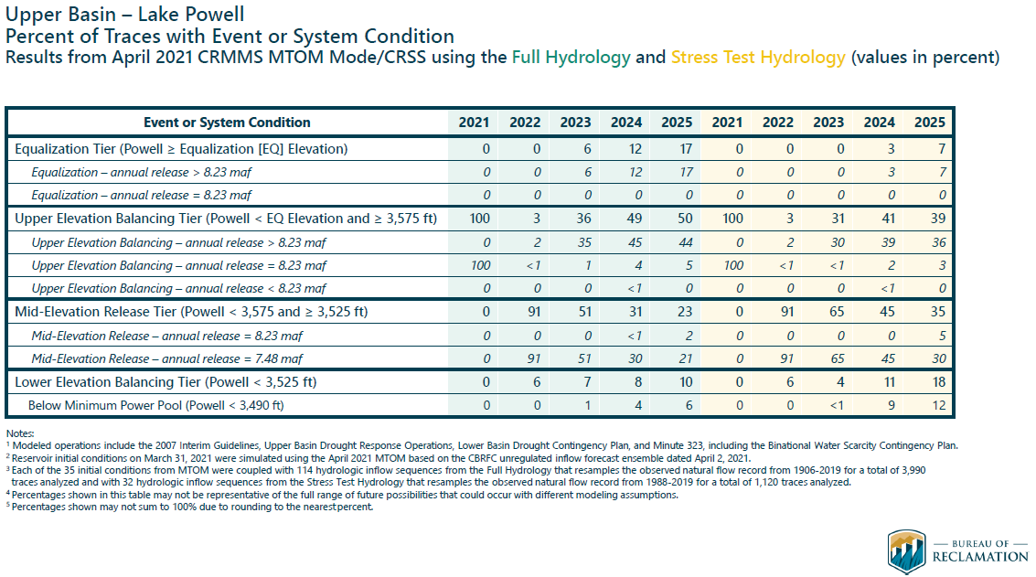

Slide 9
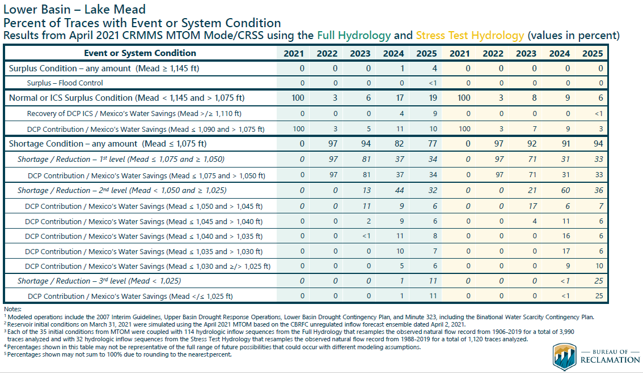

Slide 10
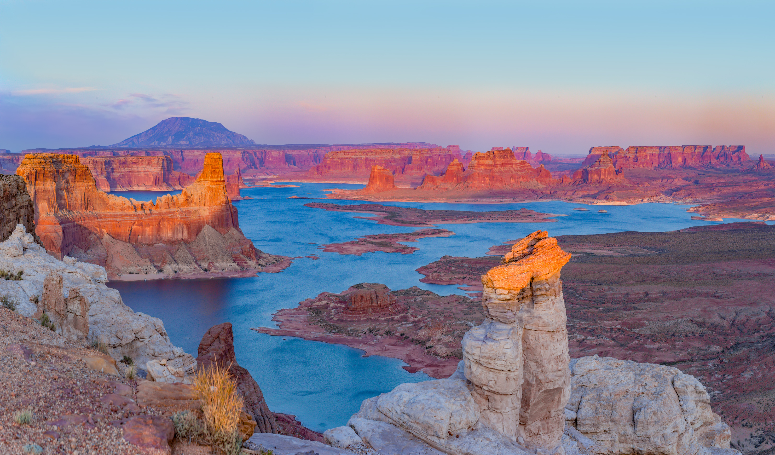
Questions?
Bret Esslin
BCEsslin@AZWater.gov
Additional Resources
Arizona Reconsultation Committee: https://new.azwater.gov/arc
Colorado Basin River Forecast Center: https://www.cbrfc.noaa.gov/
Lower Colorado Region River Operations: https://www.usbr.gov/lc/riverops.html
Upper Colorado Region River Operations: https://www.usbr.gov/uc/water/index.html

