Slide 1

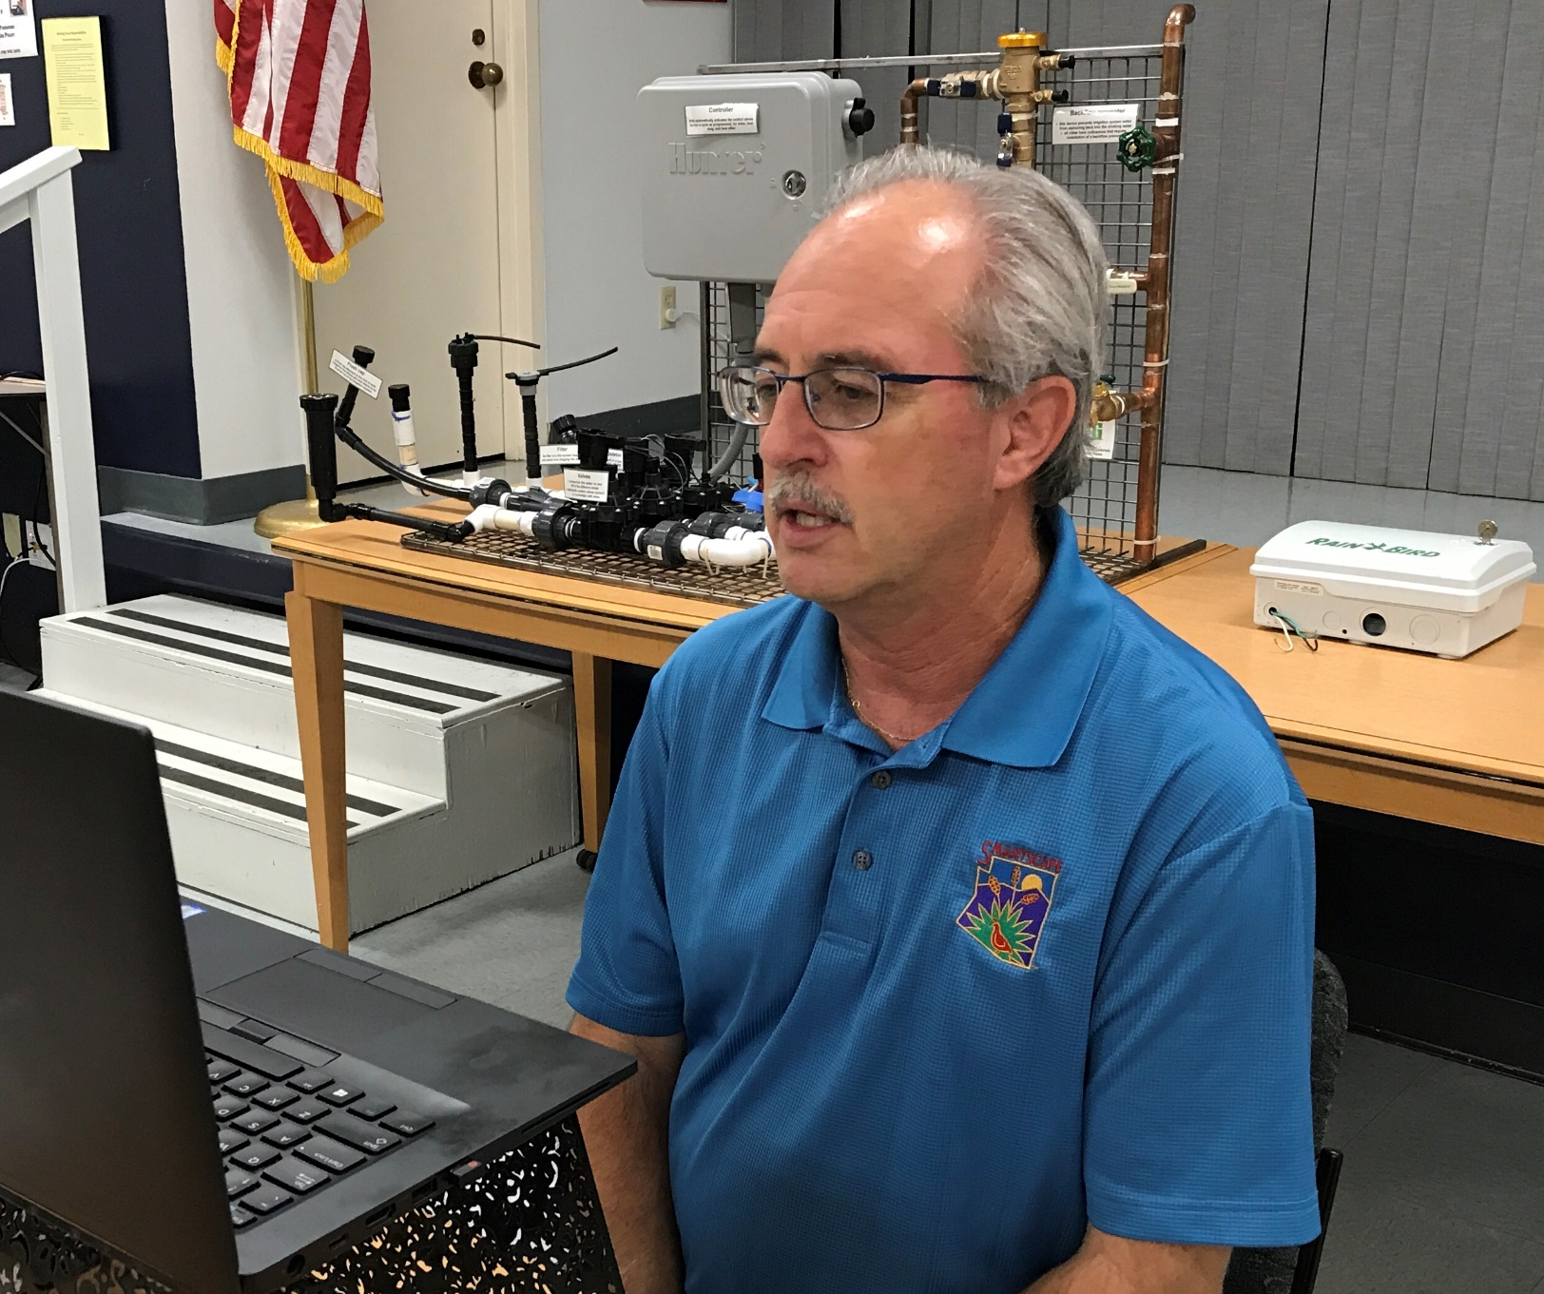
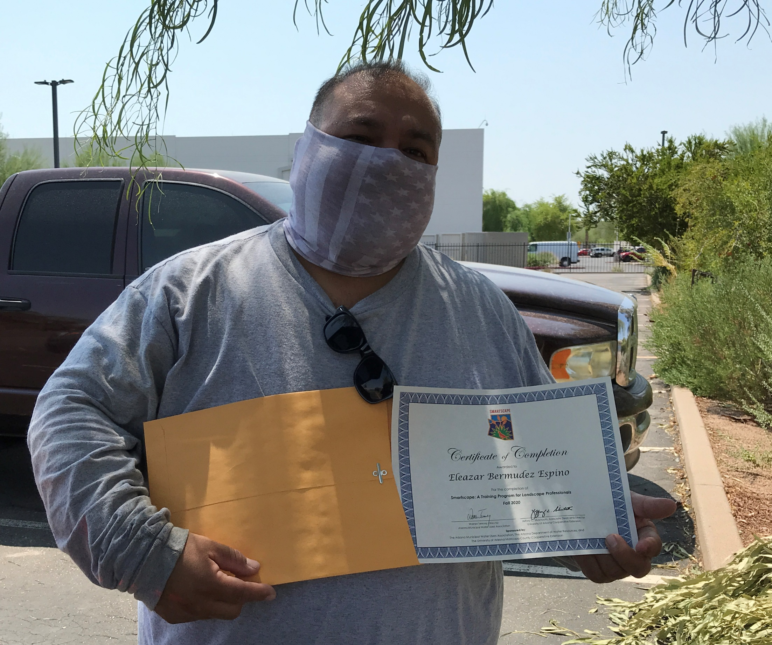
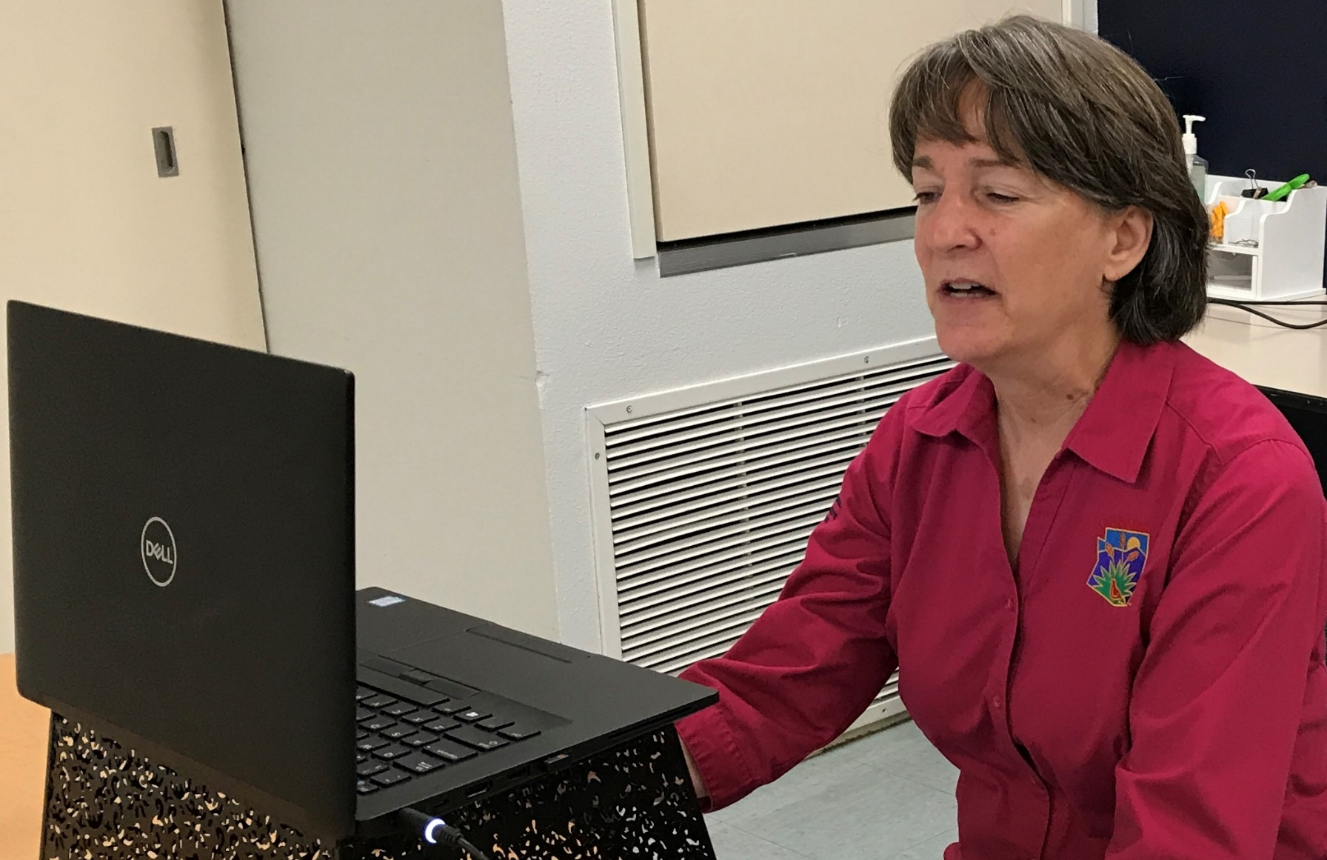
continuing programs through
the challenges of COVID-19

Slide 2
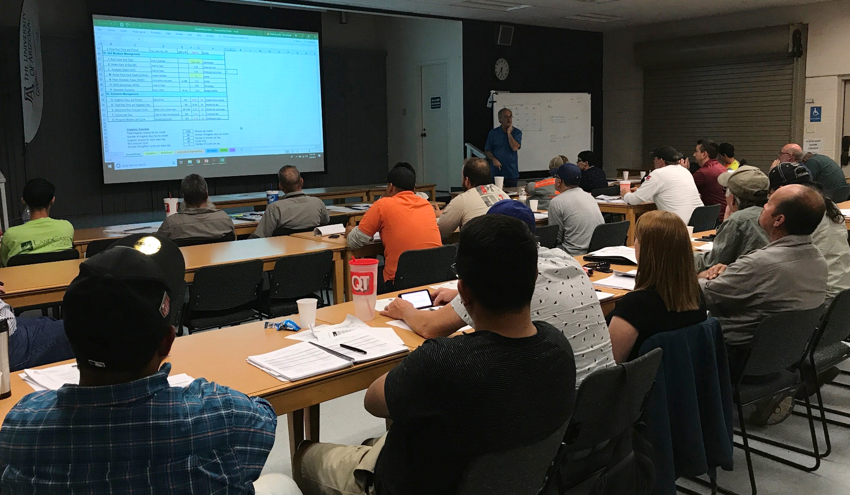
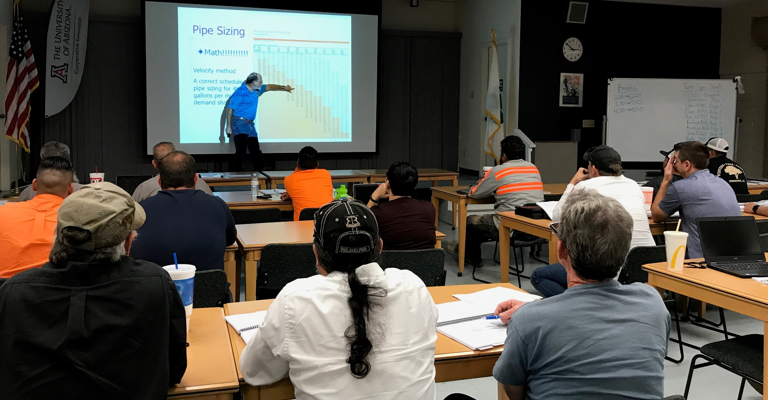
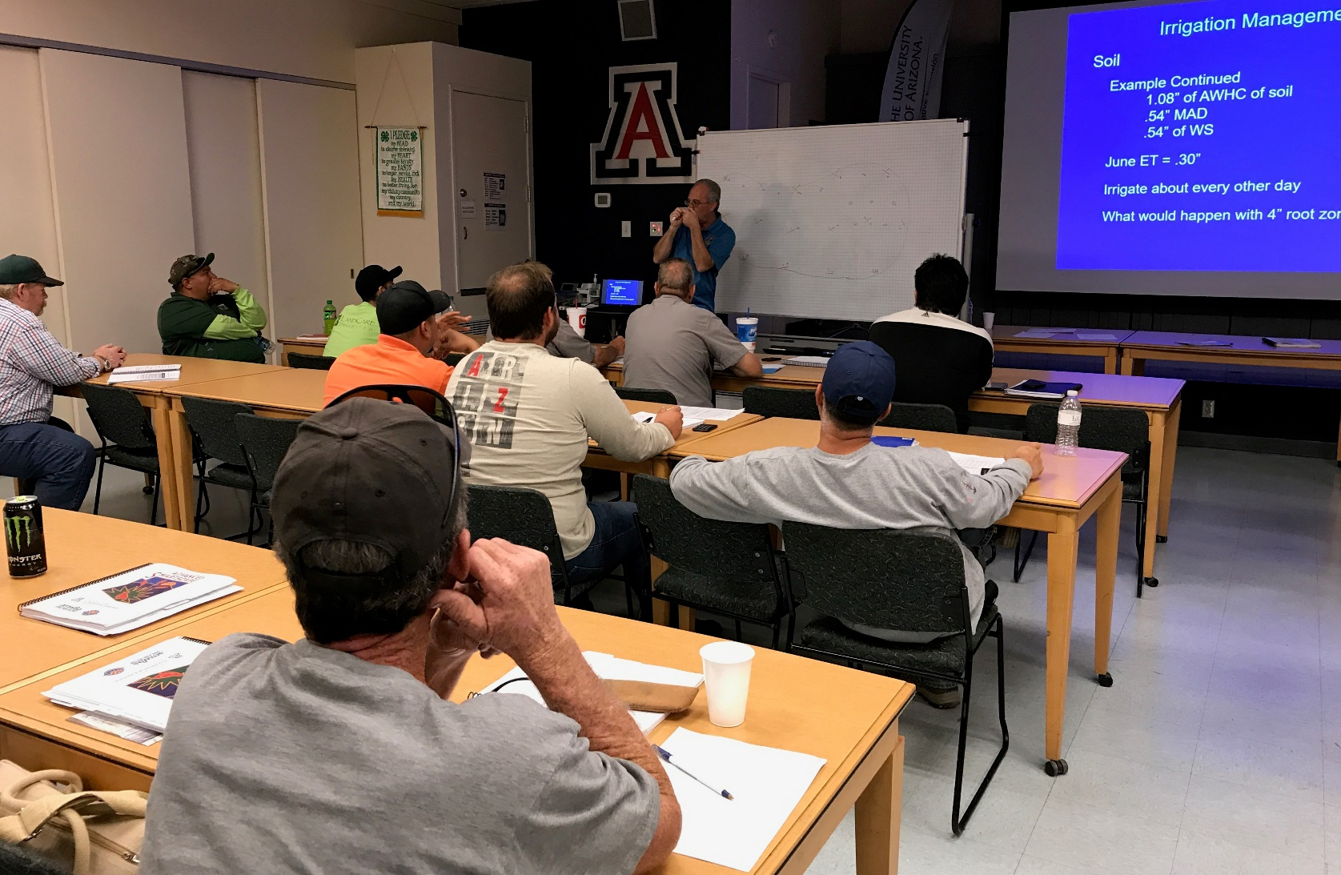
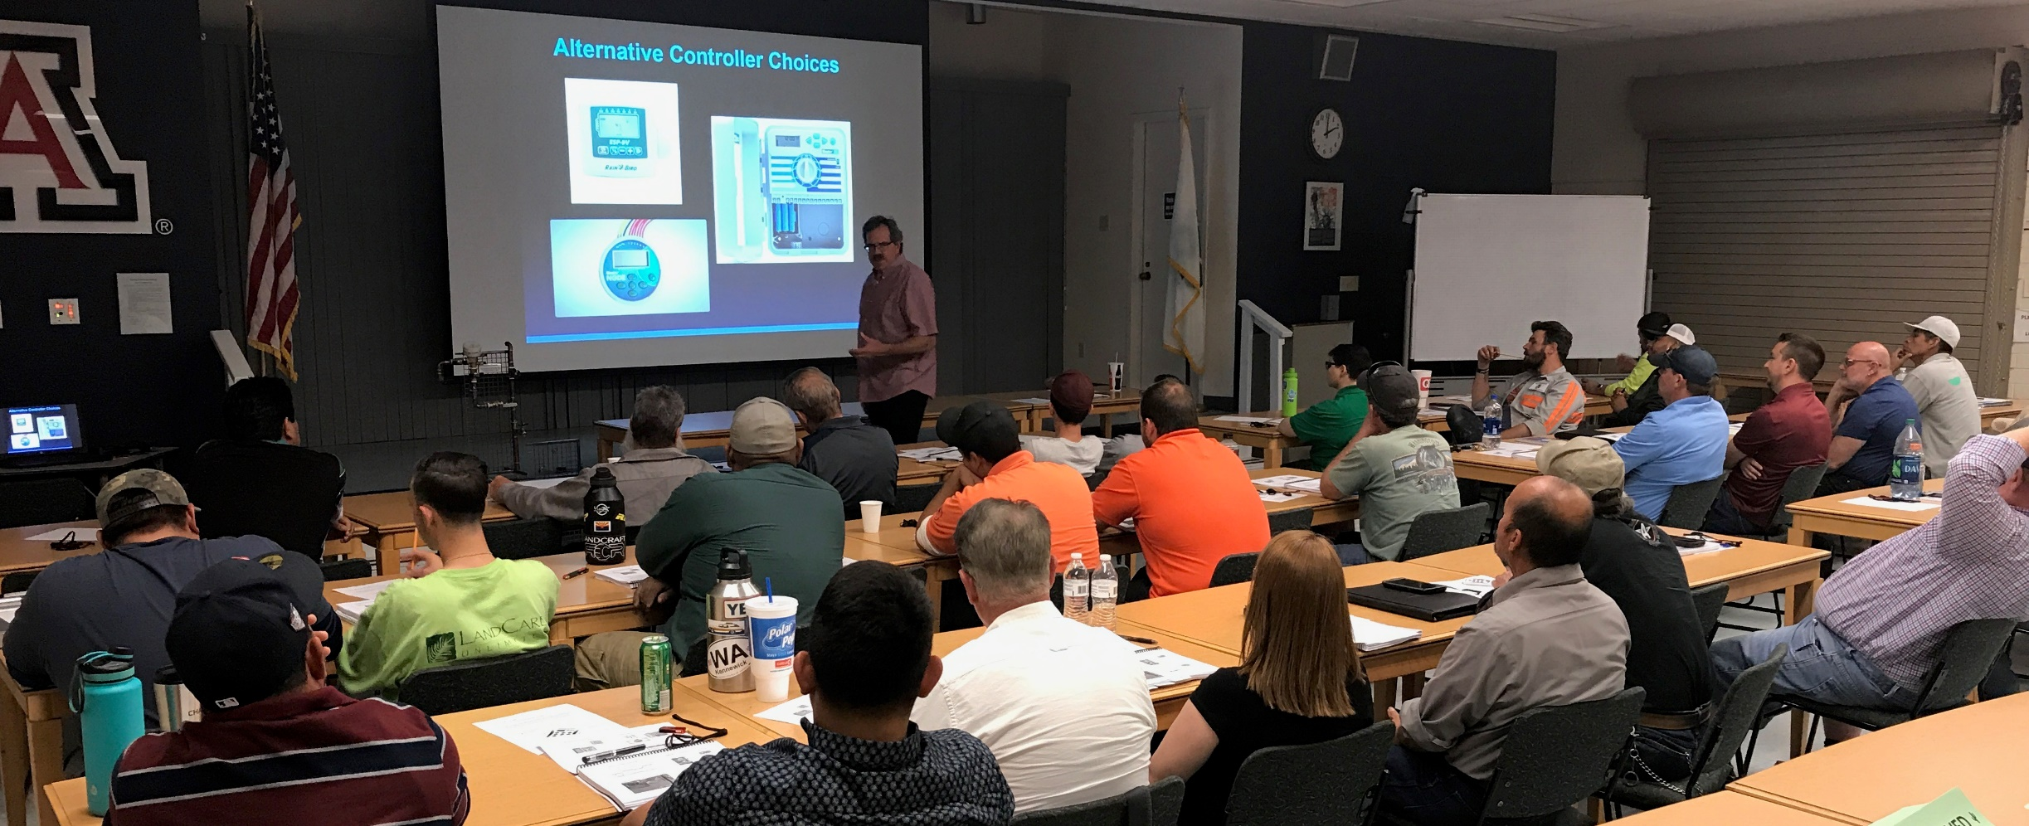
Advanced Smartscape: Irrigation

Slide 3
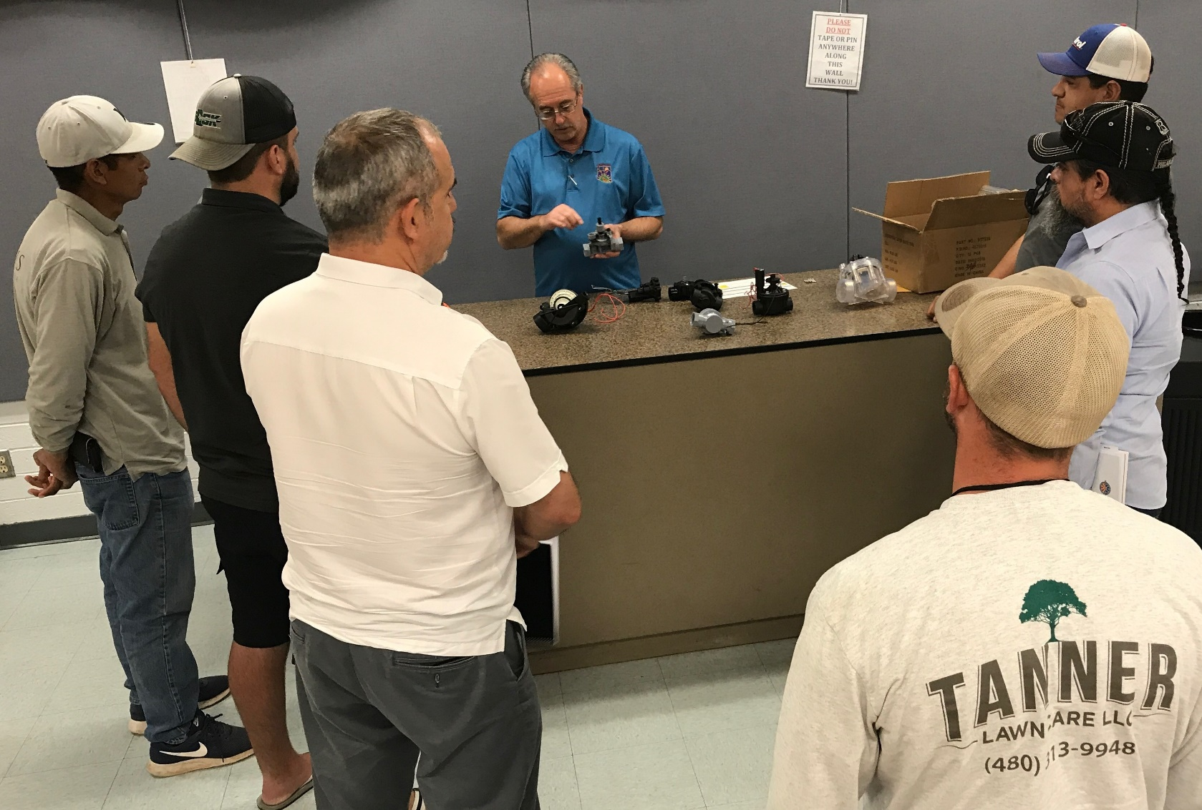
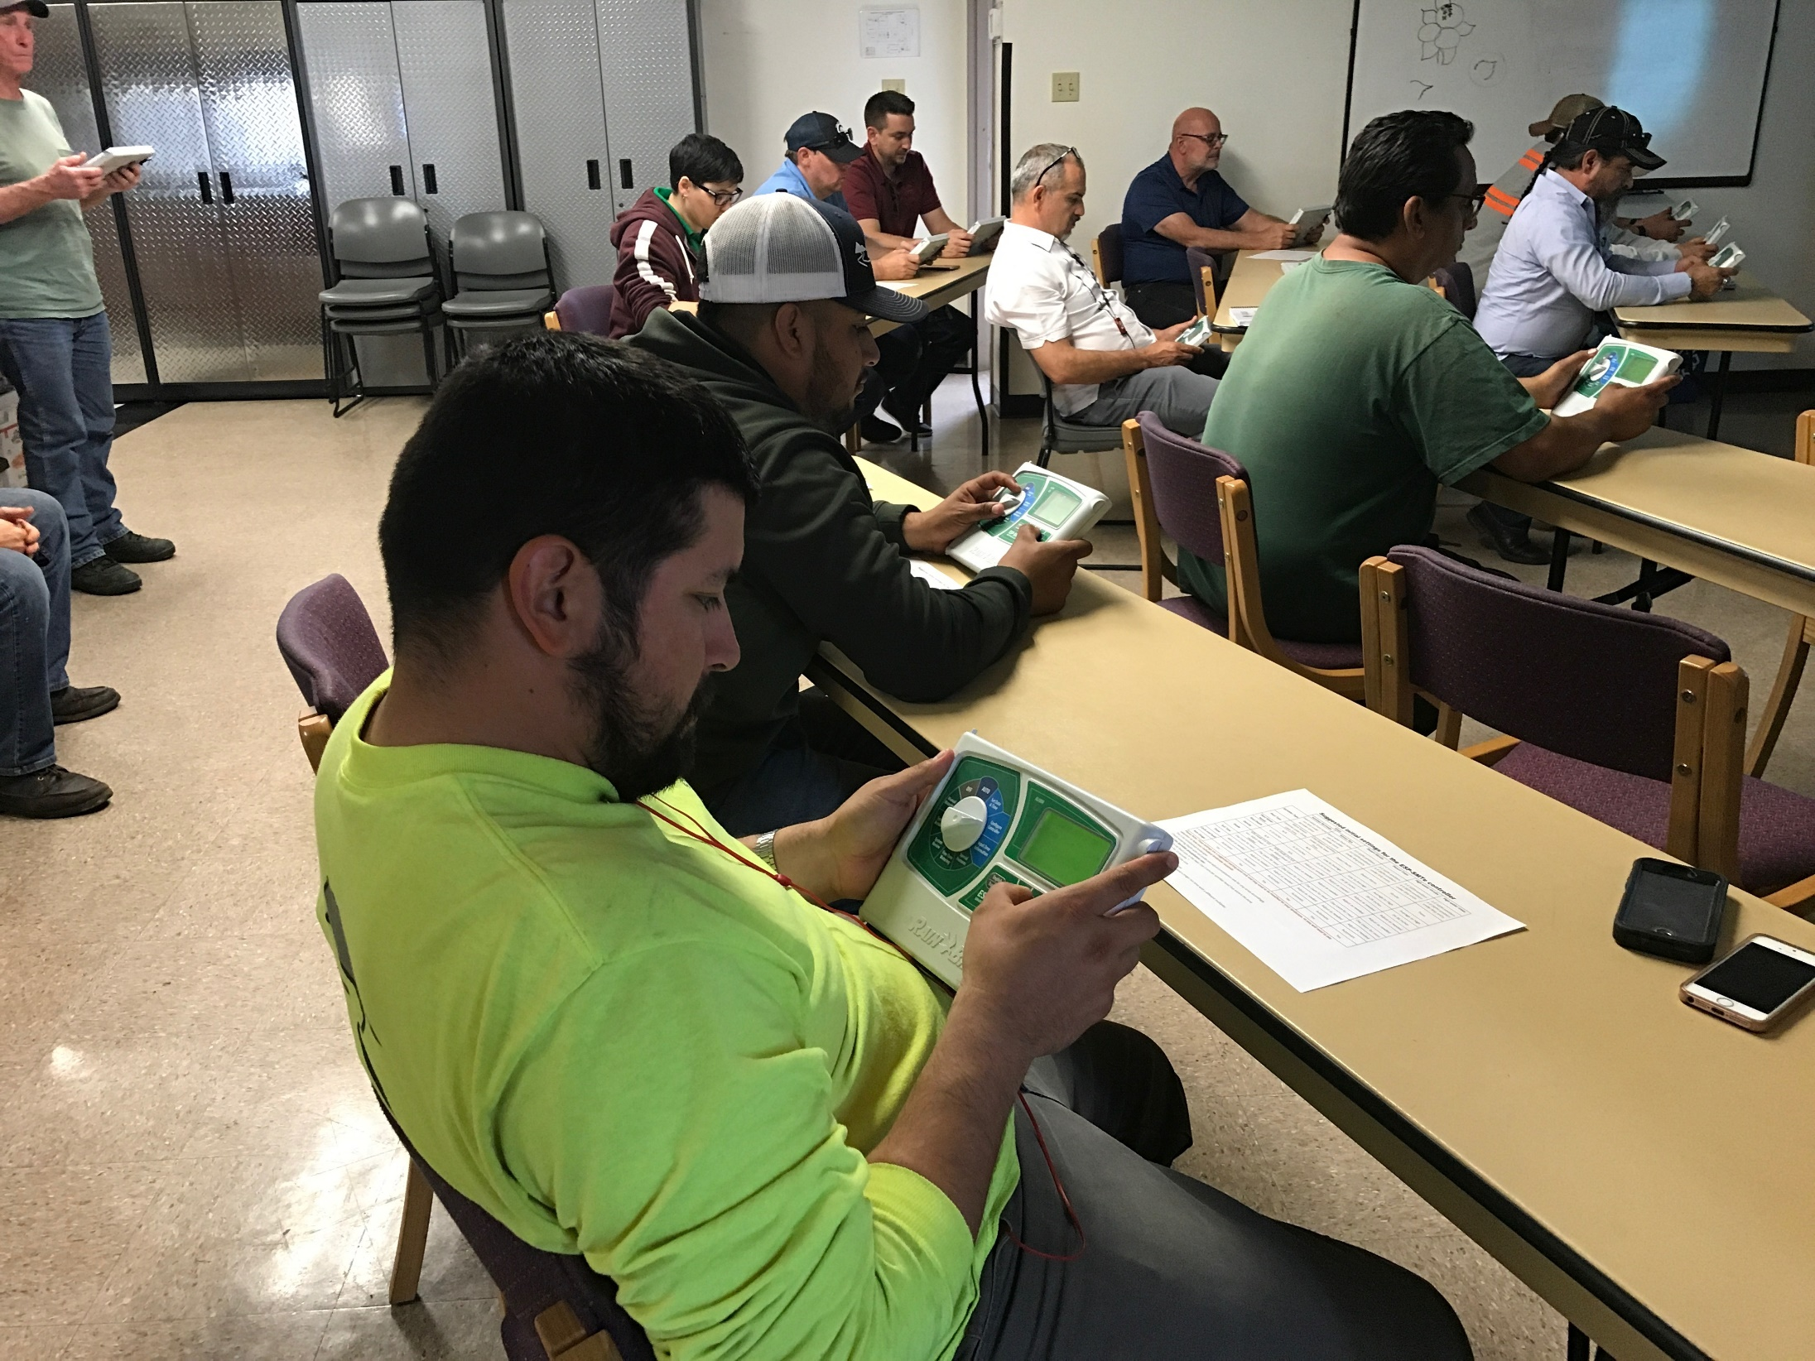
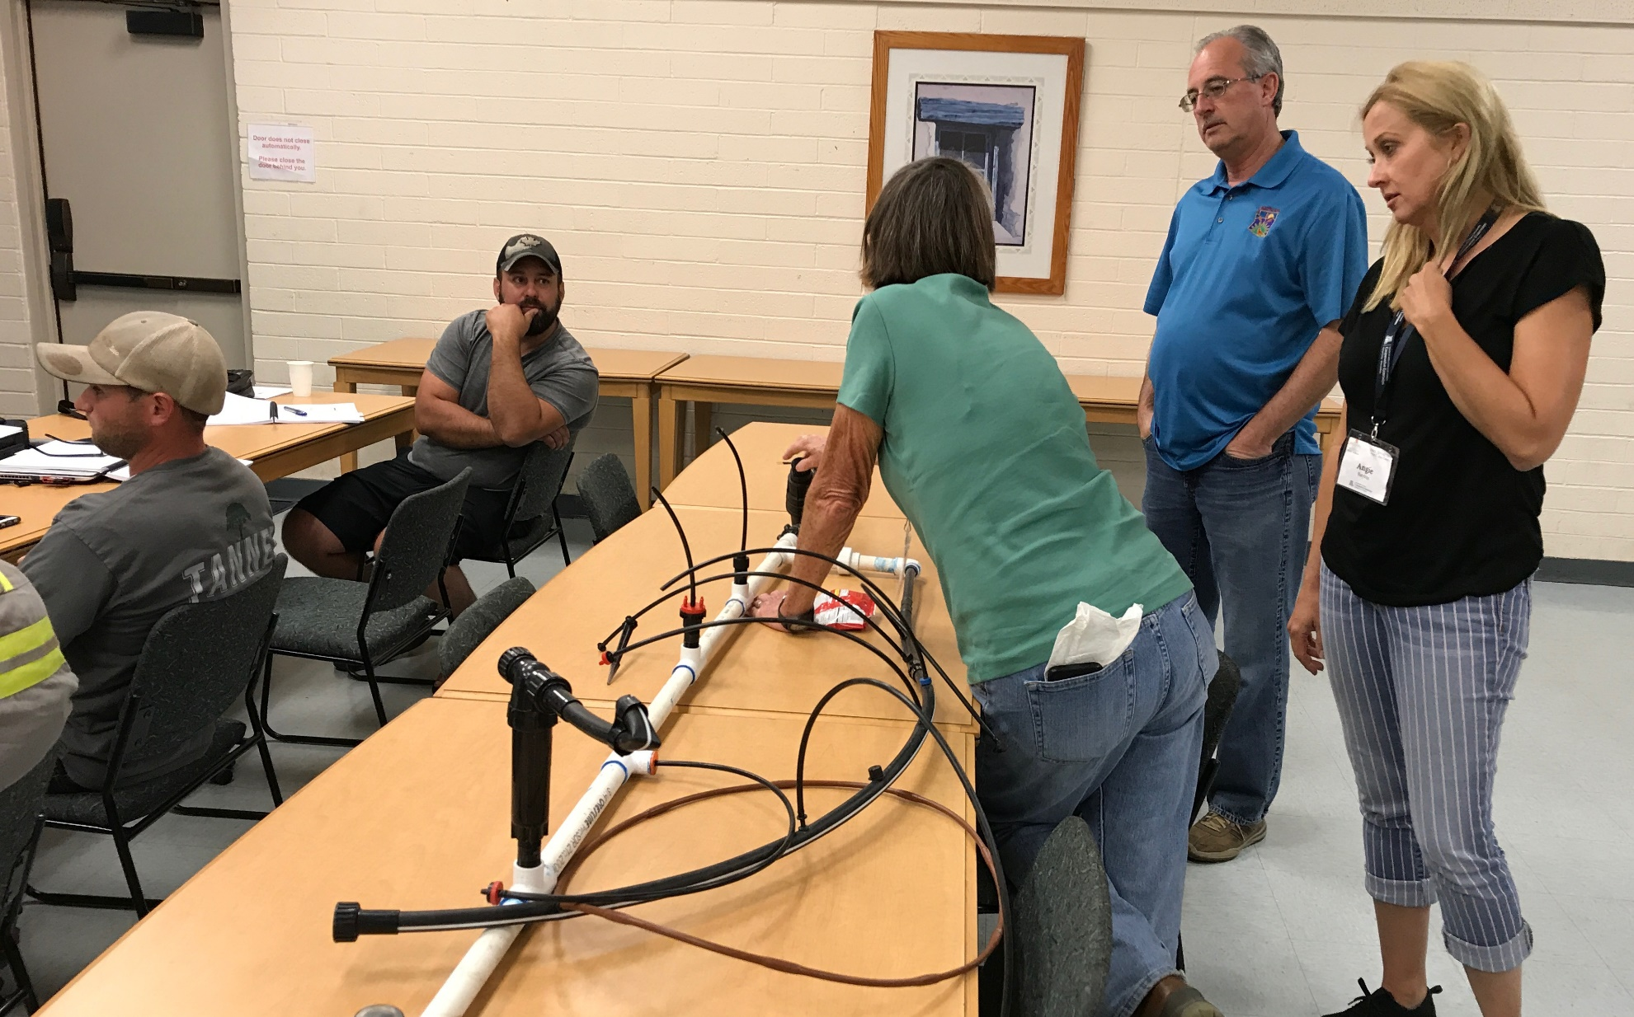
Advanced Smartscape: Irrigation

Slide 4
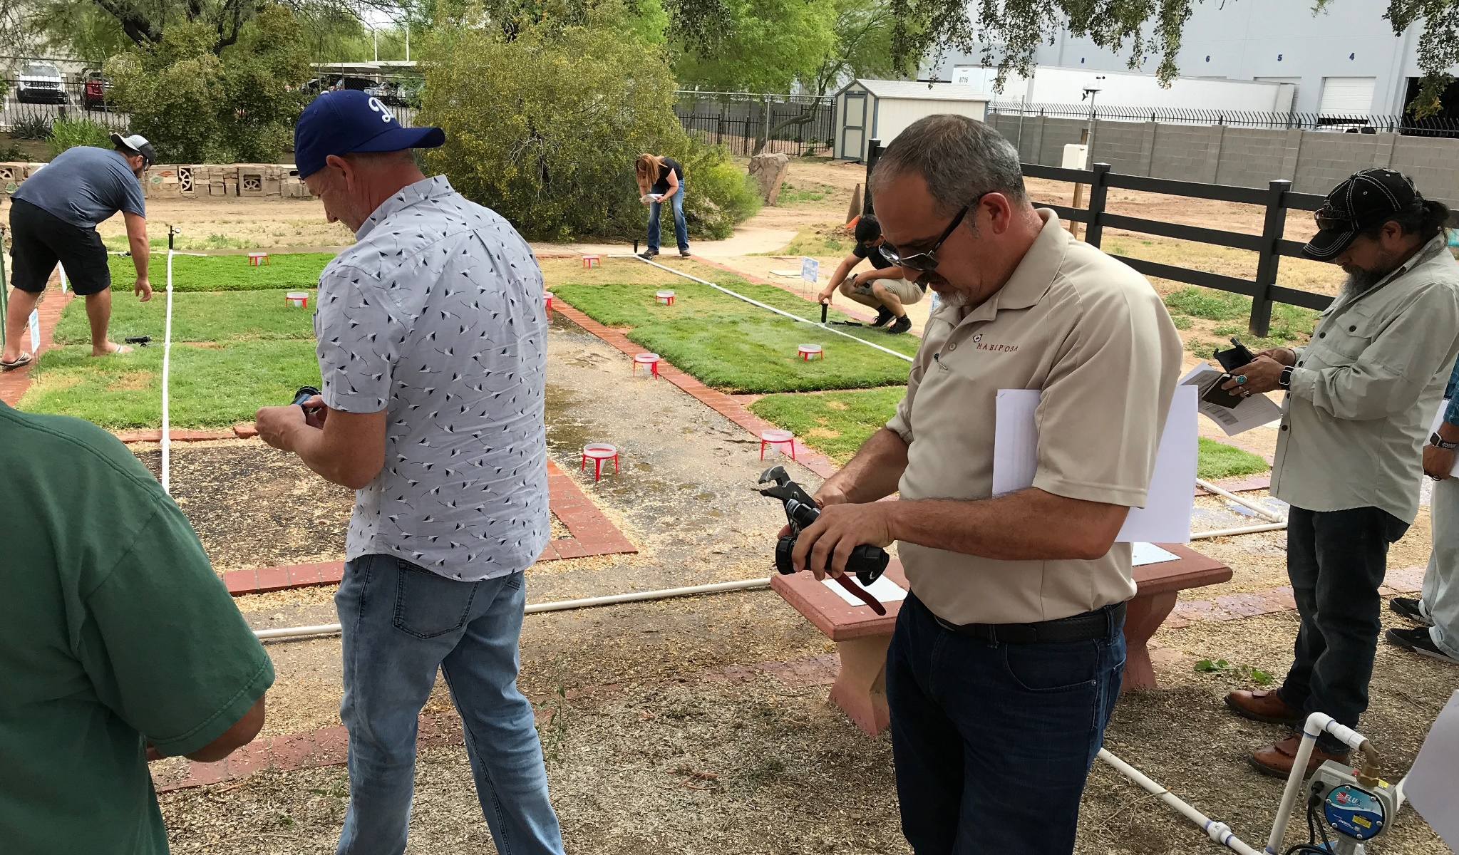
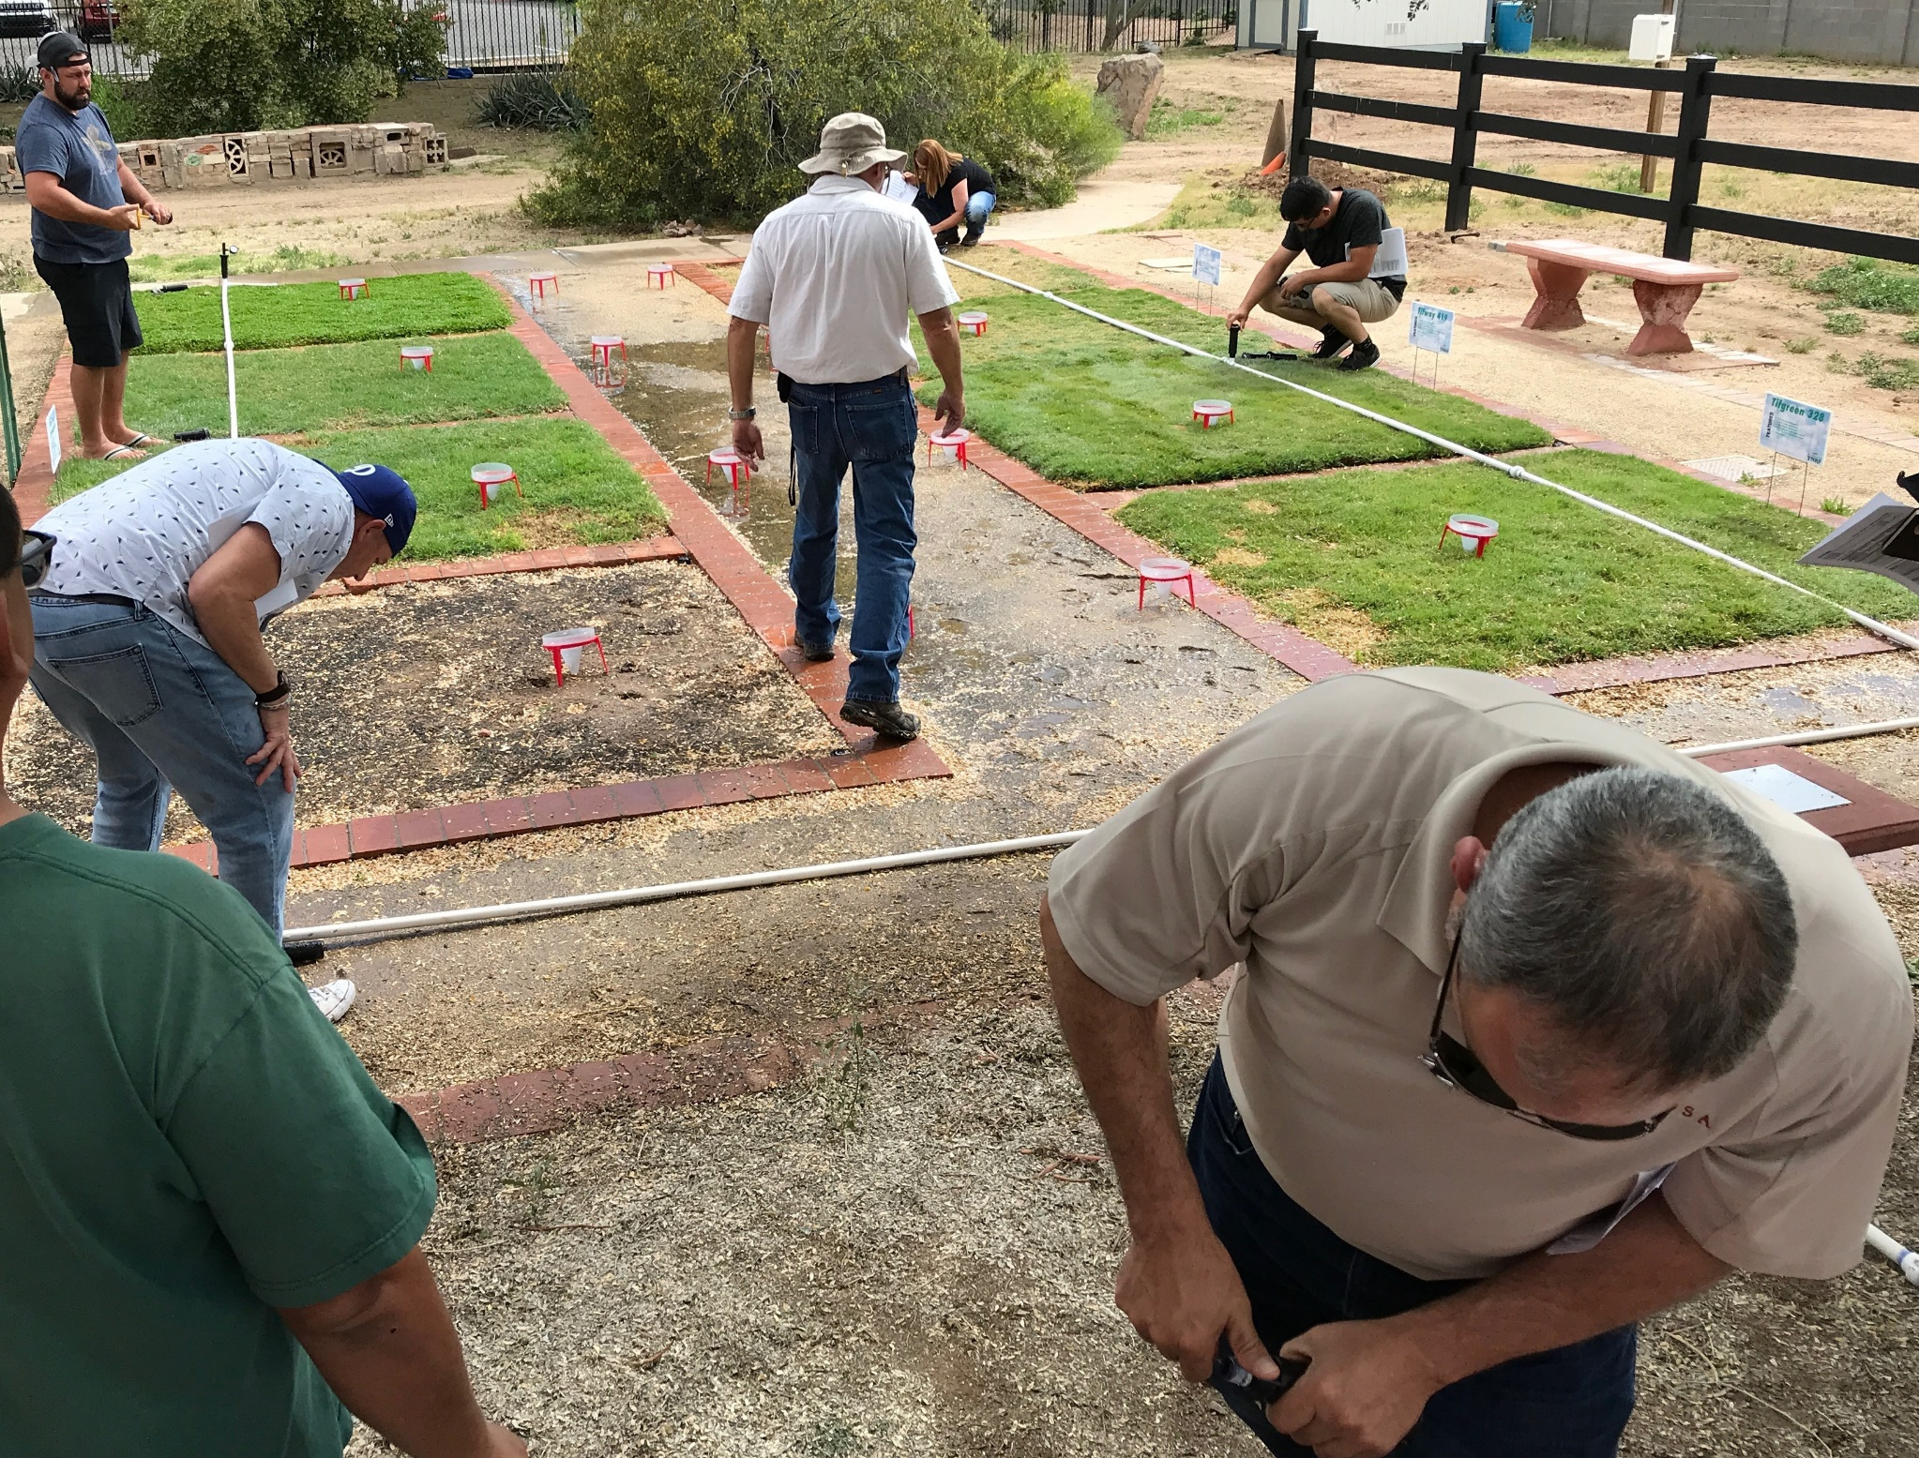
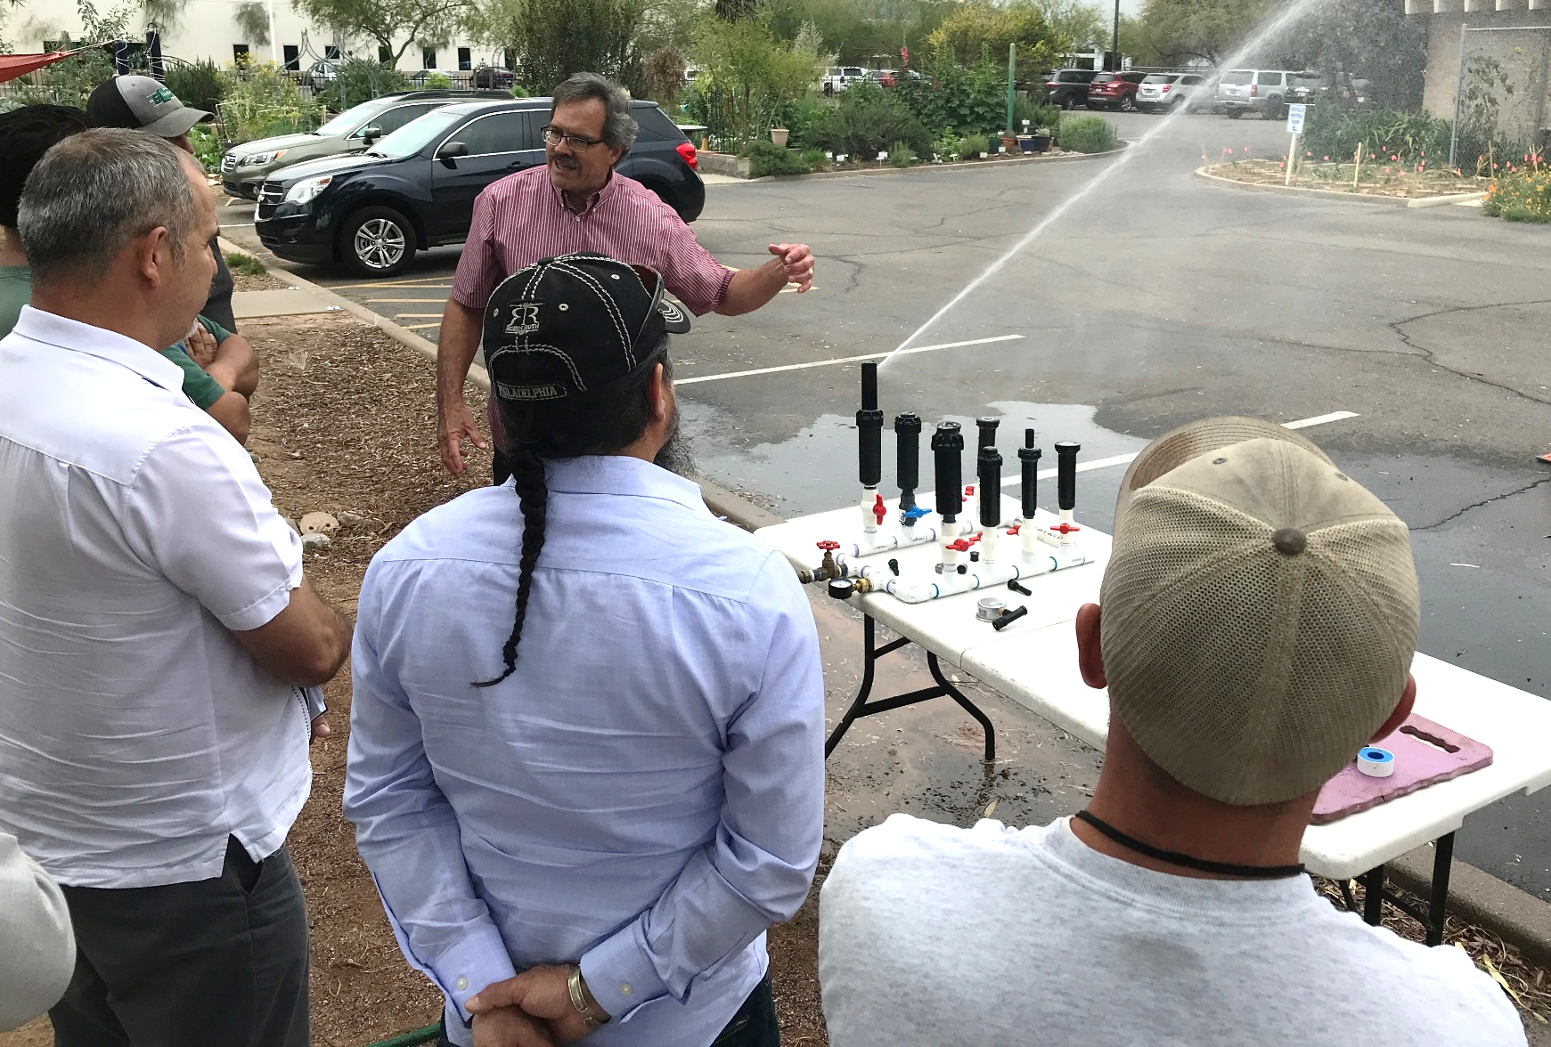
Advanced Smartscape: Irrigation

Slide 5
Our fabulous instructors integrate their knowledge and experience with the science foundation of the programs.
Smartscape
Ursula Schuch | Plants, Soil, and Water
Judy Mielke | Landscape Design and Renovation
Kirti Mathura | Plant Selection and Installation / Desert Adapted Plants
Jeff Lee | Drip Irrigation Design and Installation
Rick Templeton | Landscape Water Management & Irrigation Controllers
Steve Priebe | Maintaining Desert Adapted Plants
Shannon Scott | Plant Disorders
Spanish Smartscape
Raul Puente | Soils, Plants, and Water / Landscape Design and Renovation /
 | Desert Adapted Plants
Jaime Toledano | Plant Selection and Installation / Maintaining Desert Adapted Plants /
 | Plant Disorders
Tom Wright | Drip Irrigation Design and Installation /
 | Landscape Water Management & Irrigation Controllers
Advanced: Irrigation
Jeff Lee | Irrigation Design
Rick Templeton | Irrigation Management
Doug Donahue | Irrigation Maintenance & Installation
Additionally, representatives from ANA, ACTC, ALCA, ASLA, AZ 811, Turf School, etc., introduce students to other resources available in the Valley.

Slide 6
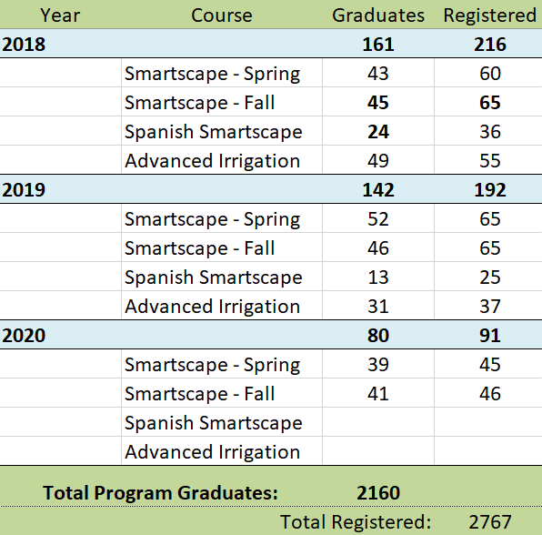
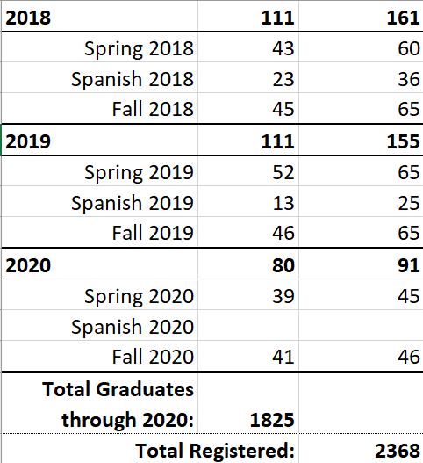
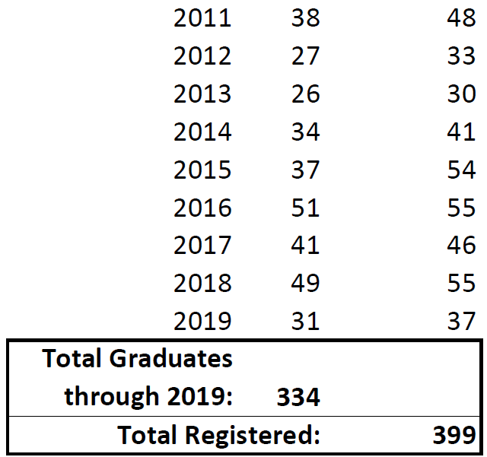
Smartscape Numbers: Registrations & Graduates
Smartscape
Year Graduates Registered
Advanced Smartscape:
Irrigation
Smartscape Programs
Year | Grads | Registered
2011 | 38 | 48
2012 | 27 | 33
2013 | 26 | 30
2014 | 34 | 41
2015 | 37 | 54
2016 | 51 | 55
2017 | 41 | 46
2018 | 49 | 55
Total Graduates through 2018: | 303
Total Registered: |  | 362

Slide 7
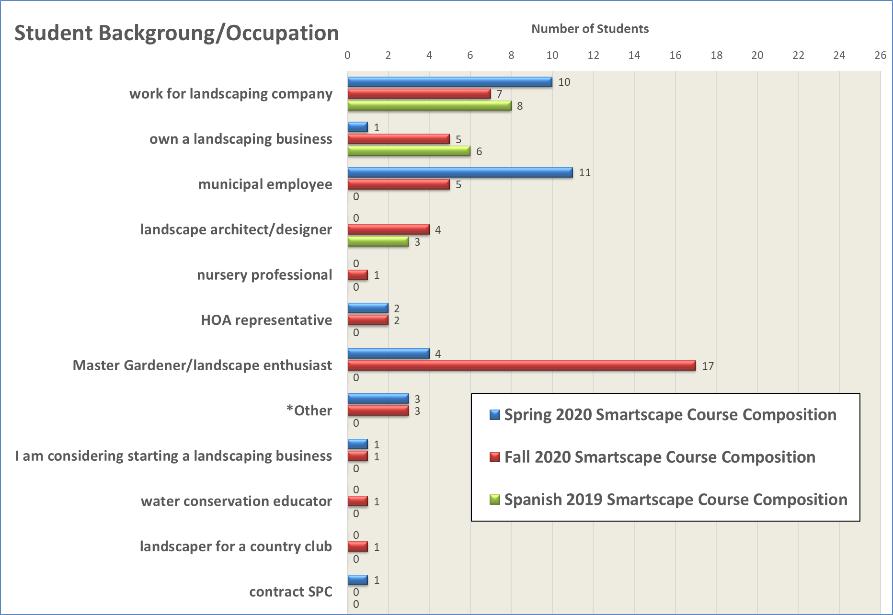
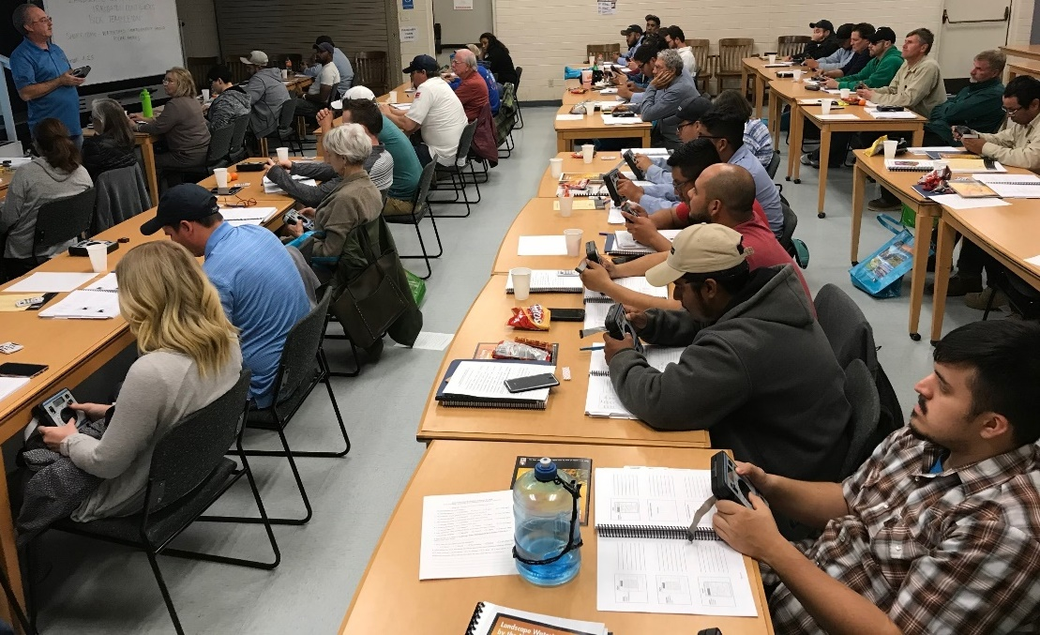
Who are we reaching?

Slide 8
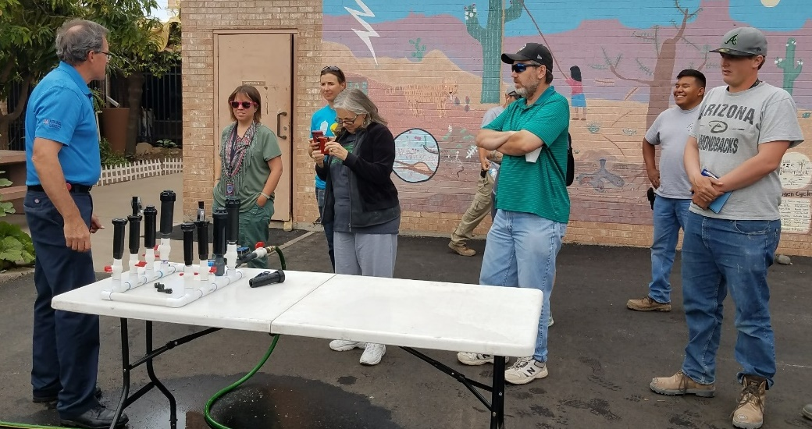
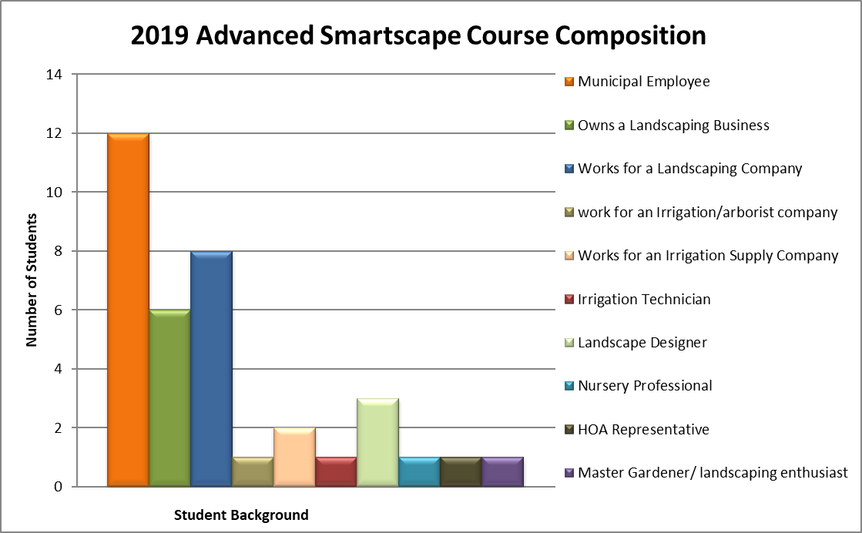
Who are we reaching?

Slide 9
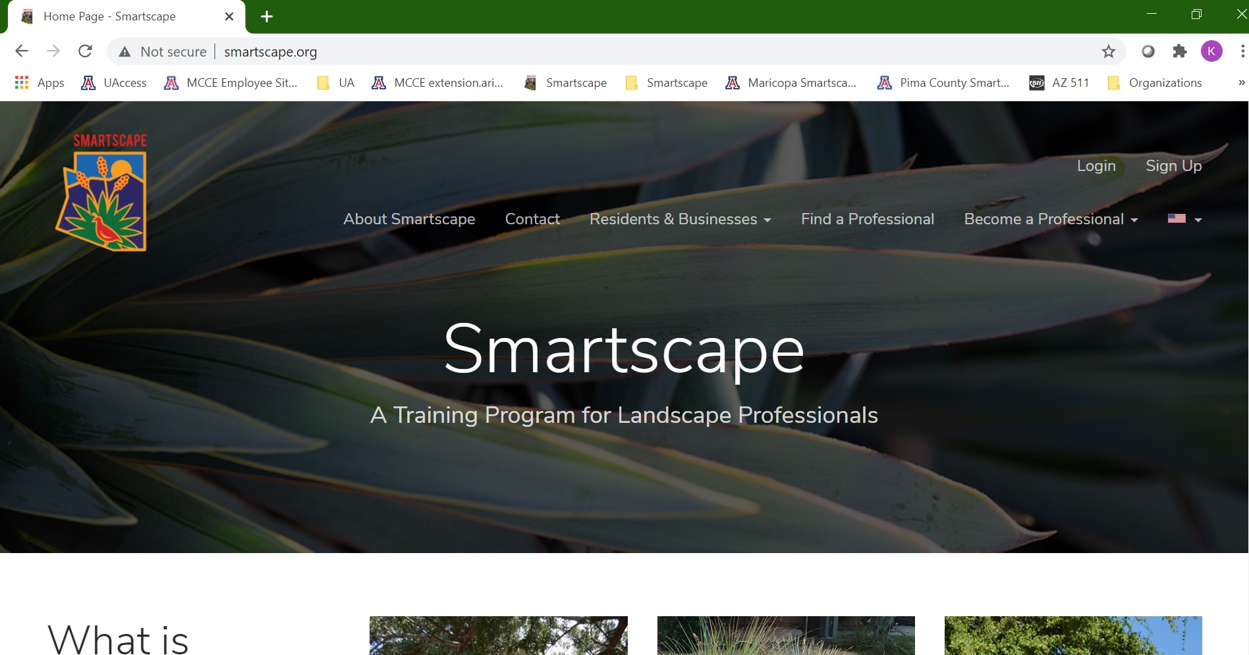
The new Smartscape website: www.Smartscape.org!

Slide 10
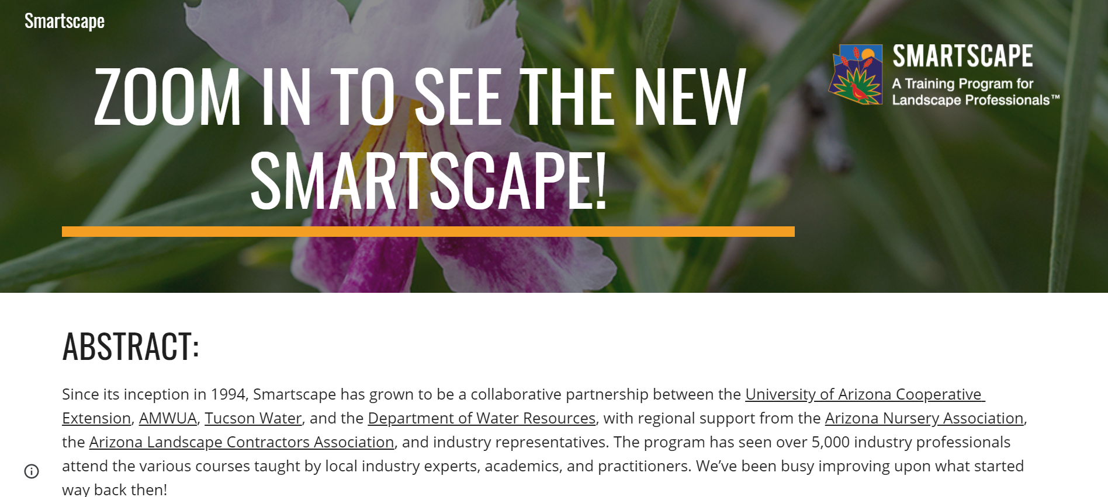
Greater collaboration with the Pima County Smartscape program

Slide 11





Thank you!
Smartscape
A valuable resource for our community!

