Slide 1

Welcome
Please keep your phone muted during the meeting.
Type your question/comment in the chat box and it will be read and addressed at the end of each presentation
During the Call to public people will have the option to speak to the Council.
With any technical difficulties please contact ADWR Help Desk at 602-771-8444 or tickets@azwater.gov

Slide 2

Santa Cruz AMA GUAC February 3, 2021

Slide 3
Meeting Agenda
Call to Order - Chair
Webinar Logistics – Kennedy Shepard, ADWR
ADWR Current Activities – Kyle Miller, ADWR
  Kyle will provide an update on agency activities
Arizona Drought Status Update – Nemesis Ortiz-Declet, ADWR
  Nemesis will provide an update on drought conditions in Arizona
WMAP Updates – Melissa Sikes, ADWR
  Melissa will provide an update on WMAP activities
Management Plans Update- Amanda Long, ADWR
  Amanda will provide updates on the 5th Management Plan Workgroups and subgroups activities
Call to Council - Council
Call to Public - Chair
Adjournment - Chair

Slide 4
Webinar Logistics
Please keep your phone muted during the meeting.
Type your question/comment in the chat box and it will be read and addressed at the end of each presentation
During the Call to public people will have the option to speak to the Council.
With any technical difficulties please contact ADWR Help Desk at 602-771-8444 or tickets@azwater.gov

Slide 5
Meeting Agenda
Call to Order - Chair
Webinar Logistics – Kennedy Shepard, ADWR
ADWR Current Activities – Kyle Miller, ADWR
  Kyle will provide an update on agency activities
Arizona Drought Status Update – Nemesis Ortiz-Declet, ADWR
  Nemesis will provide an update on drought conditions in Arizona
WMAP Updates – Melissa Sikes, ADWR
  Melissa will provide an update on WMAP activities
Management Plans Update- Amanda Long, ADWR
  Amanda will provide updates on the 5th Management Plan Workgroups and subgroups activities
Call to Council - Council
Call to Public - Chair
Adjournment - Chair

Slide 6

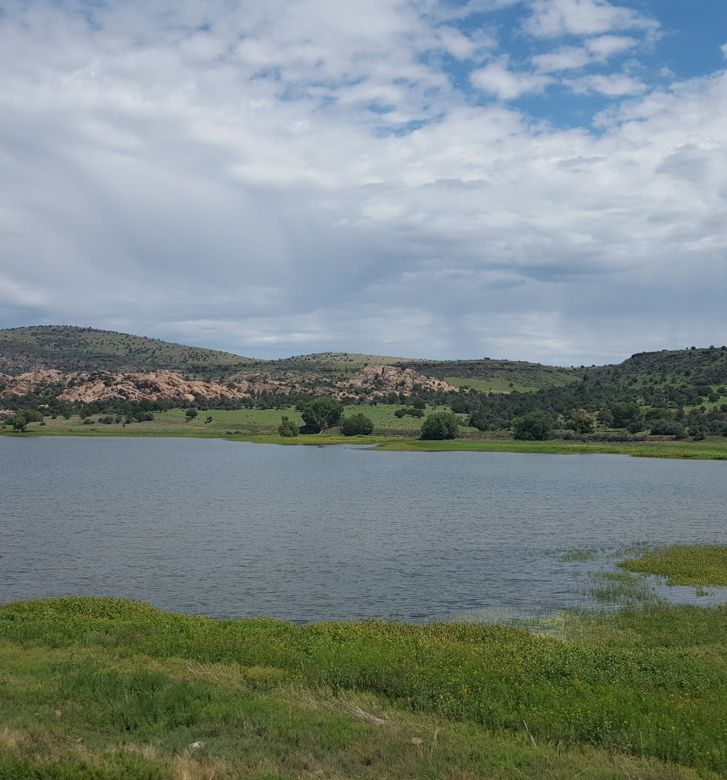

AMA Annual Reports
Non-exempt wells (>35 gpm) inside AMAs and INAs must meter well pumpage.
Users subject to reporting requirements must submit Annual Water Withdrawal and Use Reports –
    Due March 31st each year
  Volume of groundwater pumped by well
  Report movement of water
    Types and Volumes of Water Delivered/Received
    Types and Volumes of Water Stored/Recovered
    Generation/Discharge of Effluent
  May report types of end use
  Additional information related to conservation requirements or any other information the director deems necessary
Notes:
ARS 45-632(M) The director may require such other information in the report as may be necessary to accomplish the management goals of the applicable active management area.

Slide 7
ADWR Data Compilation
AMA Data
Prescott AMA
Santa Cruz AMA
Ag
Muni
Industrial
Tribal (estimated)
Tucson AMA
Phoenix AMA
Pinal AMA
Muni
Ag
Ag
Muni
Industrial
Tribal (estimated)
Ag
Muni
Industrial
Tribal (estimated)
Ag
Muni
Industrial
Statewide Water Use Estimates
Bureau of Reclamation
USGS
Recharge
Recharge
Recharge
Recharge
Recharge
Ind
Compiled AMA data is available at new.azwater.gov/ama/ama-data
Statewide Water Use information is available at www.arizonawaterfacts.com

Slide 8
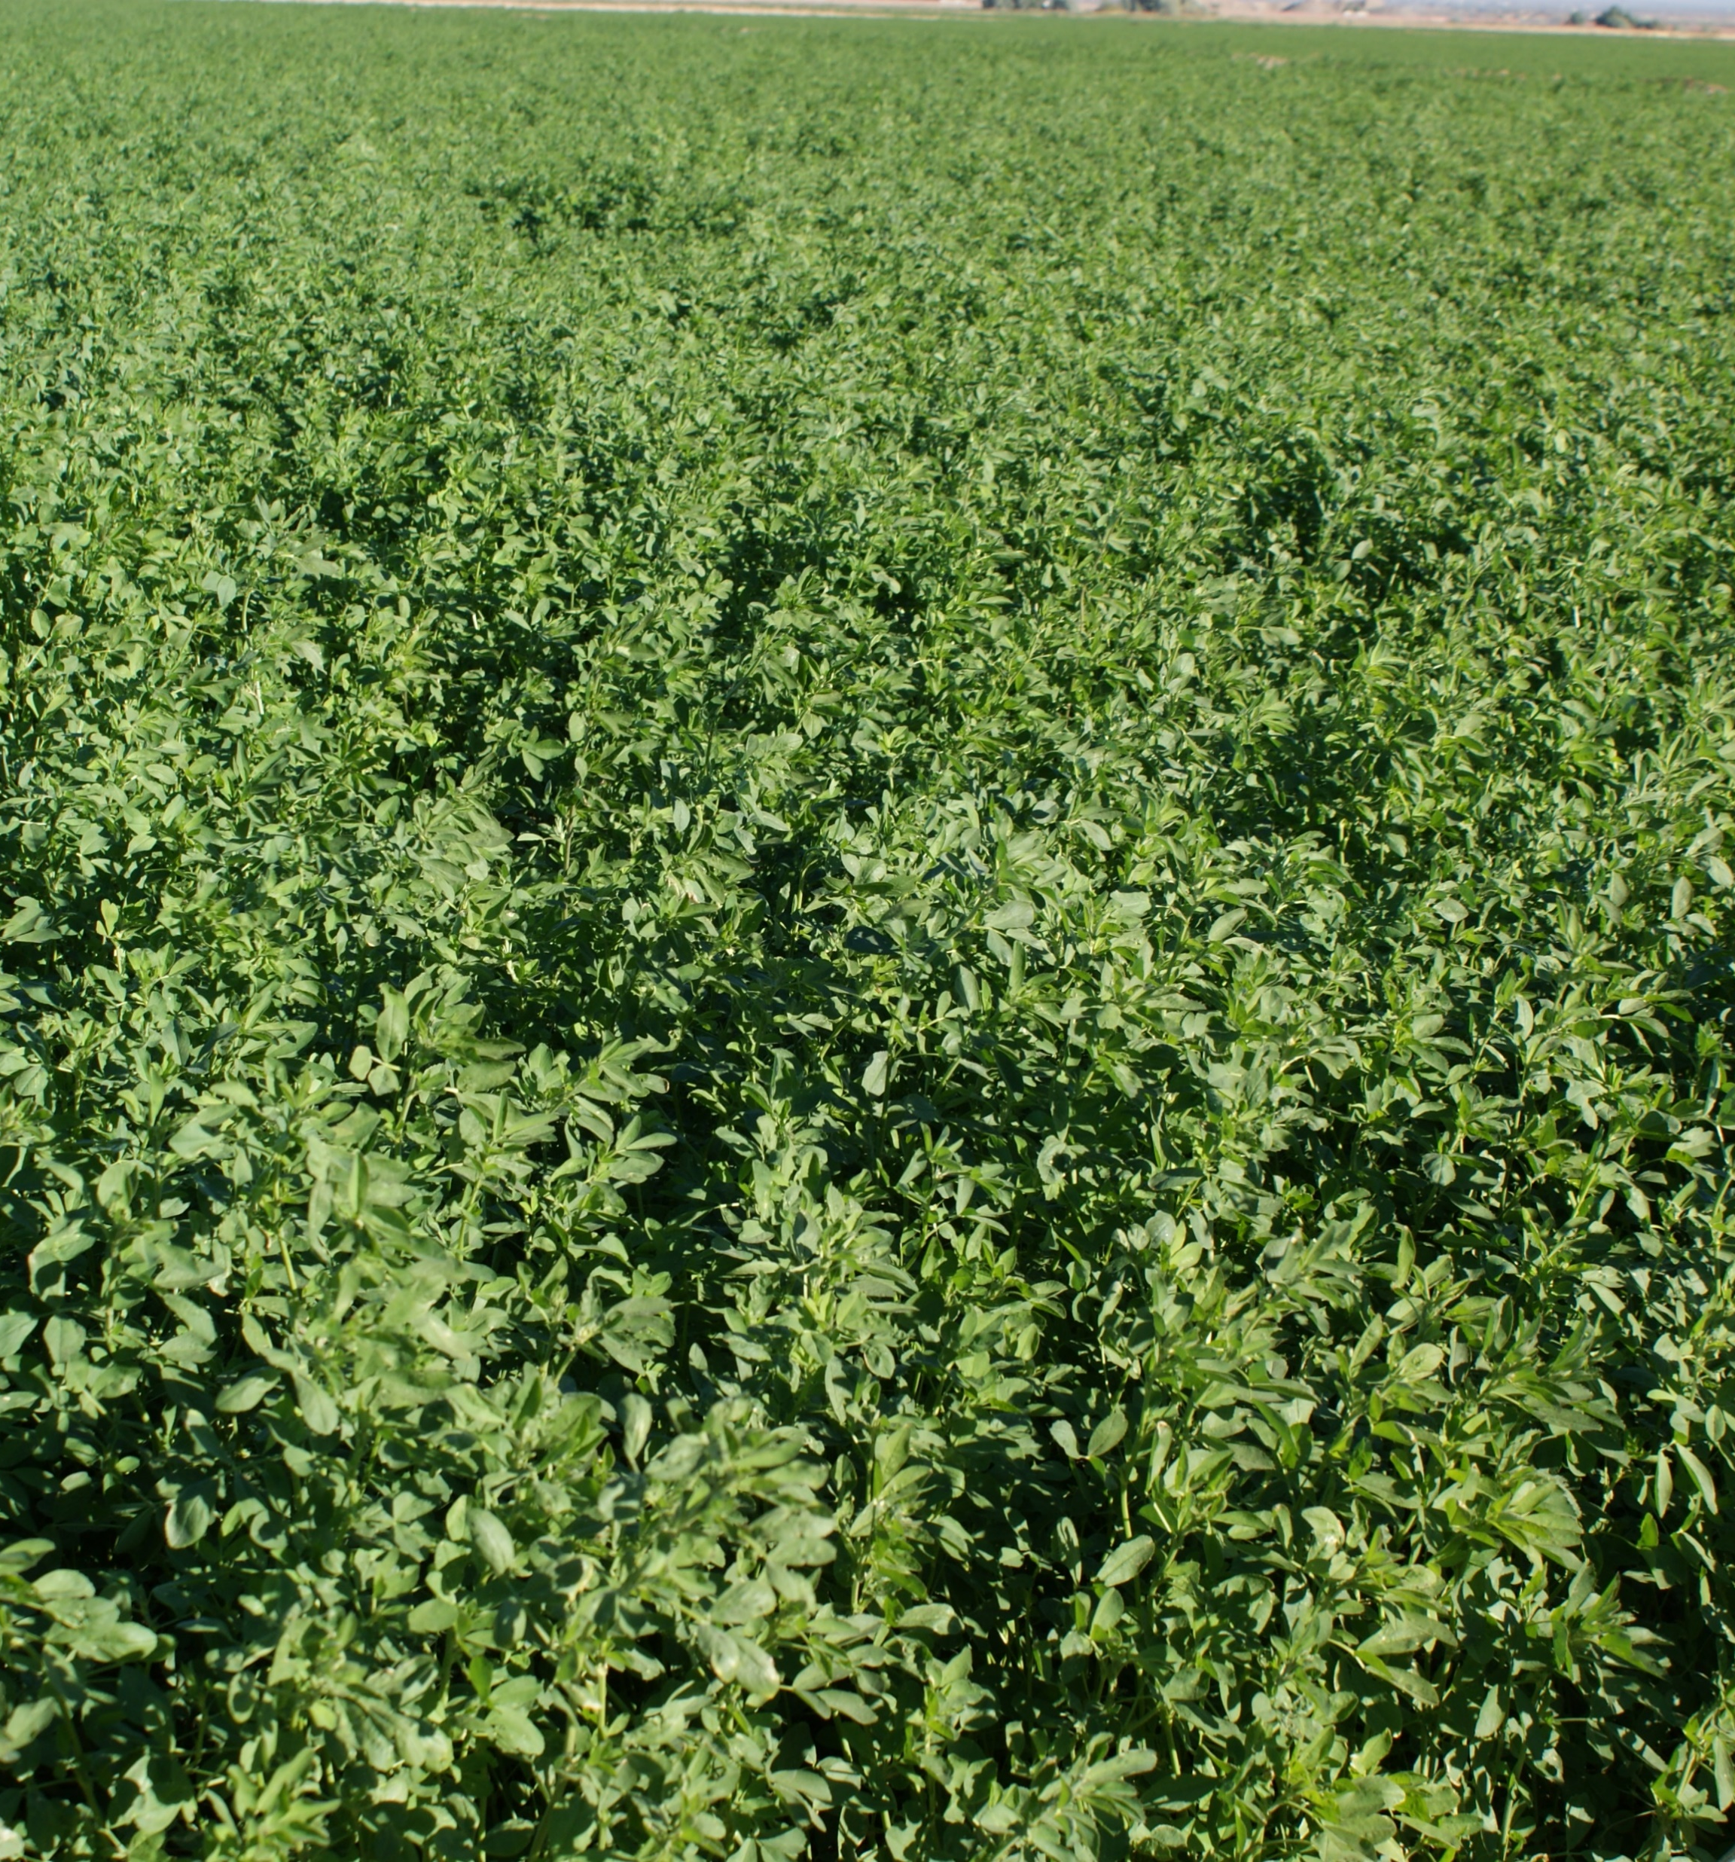
Other Data
ADWR Estimates
  Tribal water use inside the AMAs
  Exempt well water use inside the AMAs
Bureau of Reclamation
  Colorado River Diversions and Consumptive Use
  Contributions to Lake Mead
USGS
  Water Use Estimates outside the AMAs
US Census
US Bureau of Economic Analysis

Slide 9
Statewide Demand

Slide 10
Statewide Supply

Slide 11
Santa Cruz AMA
https://new.azwater.gov/ama/ama-data
13,235 AF

Slide 12
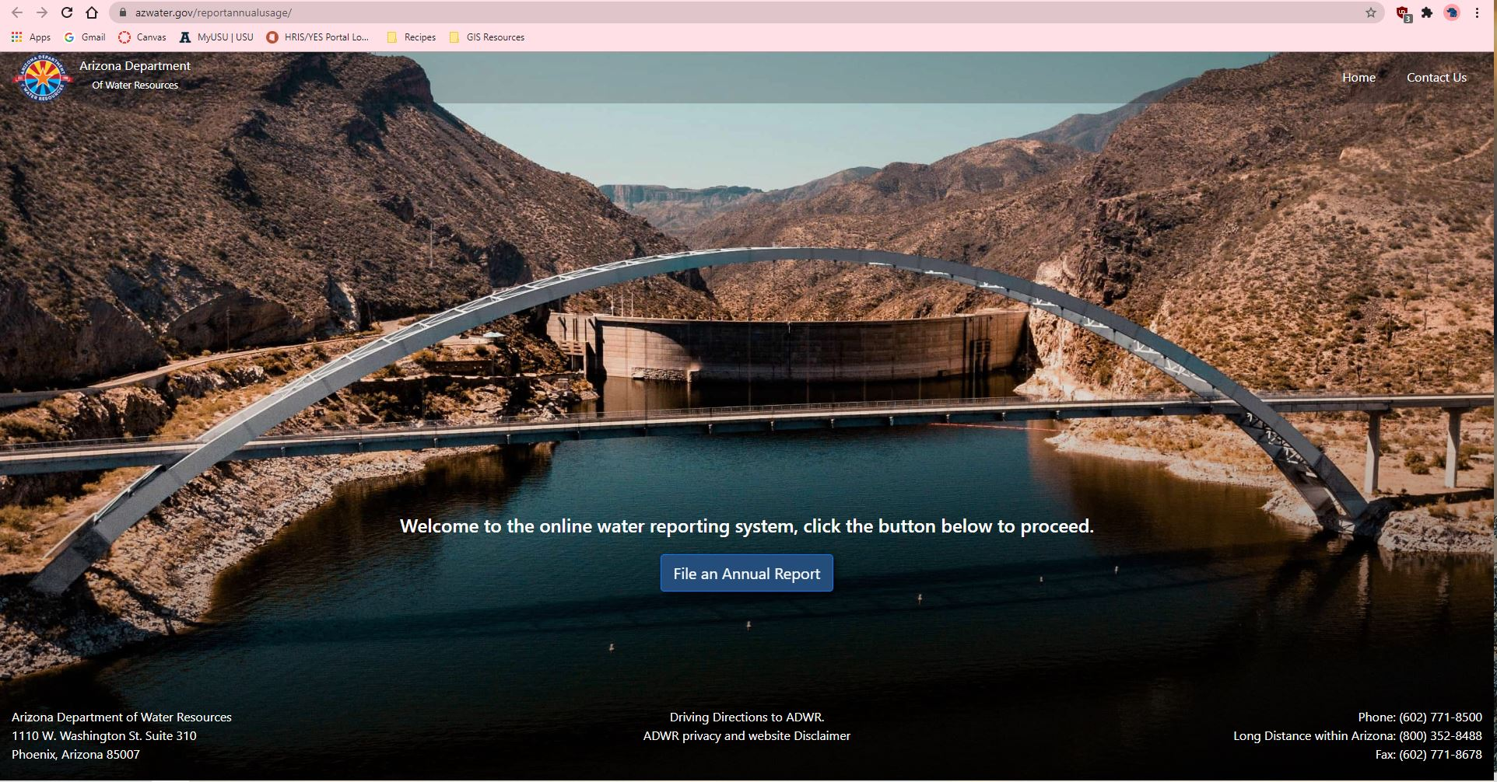
https://www.azwater.gov/reportannualusage/

Slide 13
Meeting Agenda
Call to Order - Chair
Webinar Logistics – Kennedy Shepard, ADWR
ADWR Current Activities – Kyle Miller, ADWR
  Kyle will provide an update on agency activities
Arizona Drought Status Update – Nemesis Ortiz-Declet, ADWR
  Nemesis will provide an update on drought conditions in Arizona
WMAP Updates – Melissa Sikes, ADWR
  Melissa will provide an update on WMAP activities
Management Plans Update- Amanda Long, ADWR
  Amanda will provide updates on the 5th Management Plan Workgroups and subgroups activities
Call to Council - Council
Call to Public - Chair
Adjournment - Chair

Slide 14
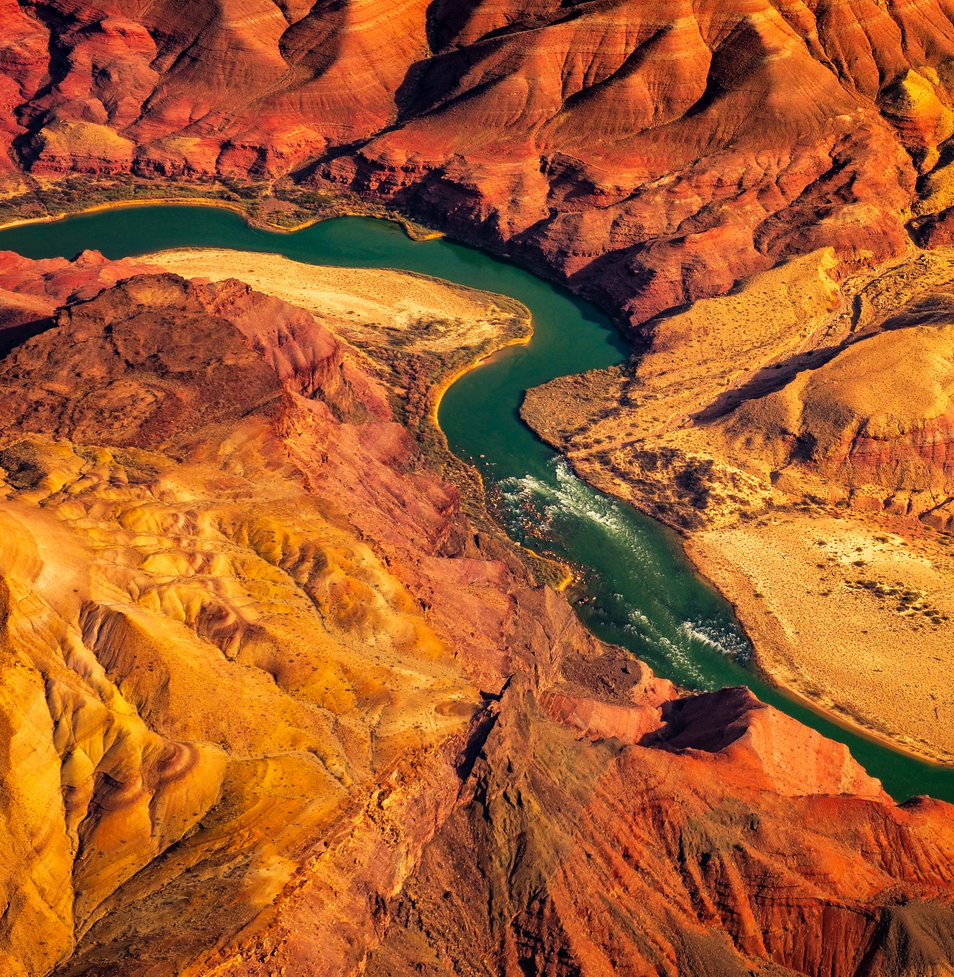

Arizona Drought Status & Outlook
Némesis Ortiz-Declet
Drought & Conservation Coordinator
February 3, 2021
Arizona Department of Water Resources

Slide 15

Overview
Water Year 2019 vs Water Year 2020
Water Year 2020 – Summer
Calendar Year 2020 Long-term Drought Status
Water Year 2021 to date Precipitation
Monthly Short-term Drought Status – Past 5 Months
January 2020 Short-Term Drought Status
US Seasonal Drought Outlook
2020 Arizona Drought Preparedness Annual Report

Slide 16
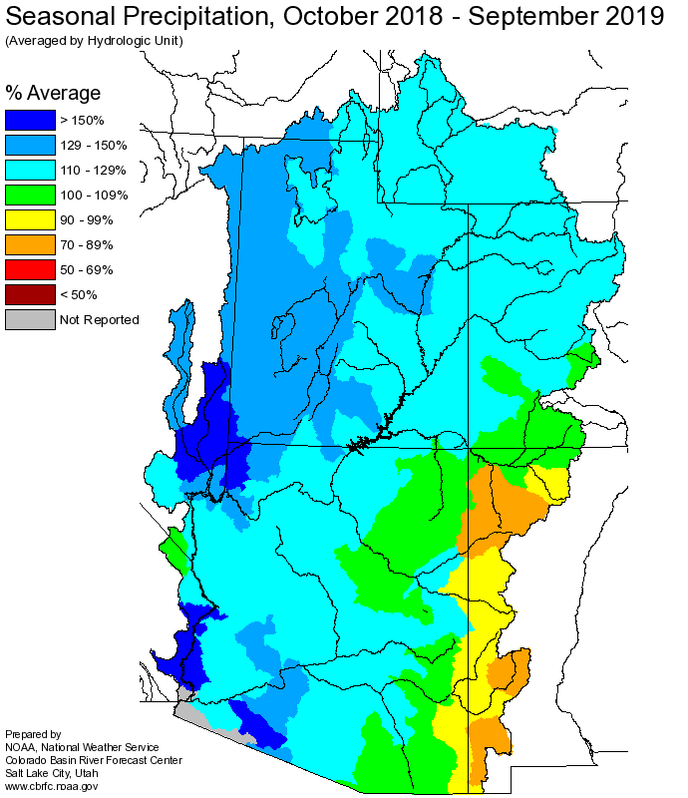
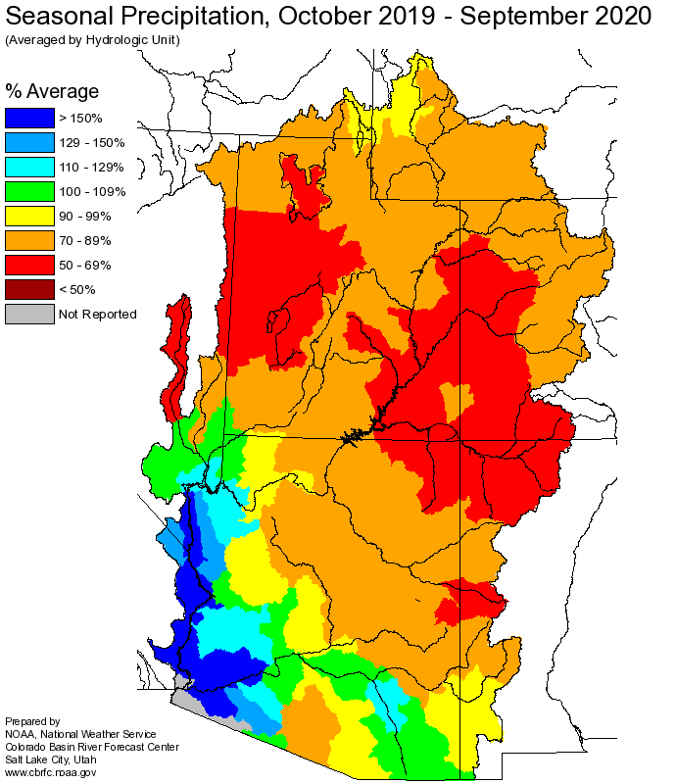

Water Year 2019 vs Water Year 2020
Notes:
These are Seasonal Precipitation maps of the Colorado River Watershed for total Water Year 2019 vs Water Year 2020 – Water Years start on October 1st and end on September 30th
Water Year 2019 started in 2018, which was an extremely dry year, and was followed by a very wet winter that reduced drought throughout the Colorado River Watershed.
On the left-side map there are green and blue colors throughout the upper and lower basin, which indicate about 100% to 150% of average precipitation was received in the watershed, this means that precipitation conditions were good for the Water Year 2019 period.
On the right-side we have the Colorado River Watershed map for Water Year 2020, which started after a dry monsoon season in 2019 and was also followed by a wet winter, however, it did not do as well as the previous WY as is represented by the orange and red colors throughout the watershed, which indicate that those areas received about 50% to 89% of average seasonal precipitation.

Slide 17
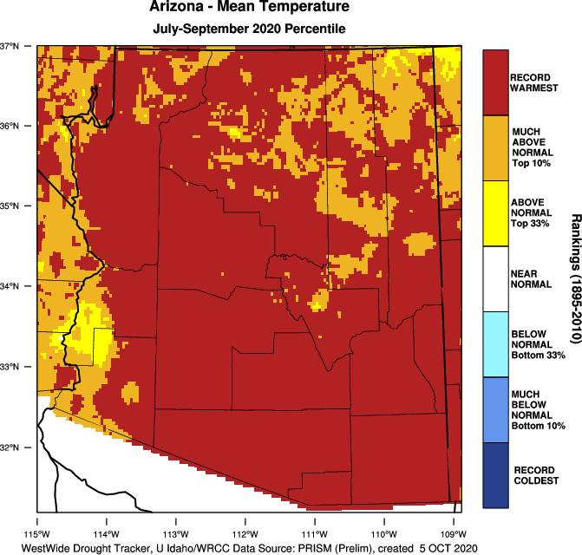
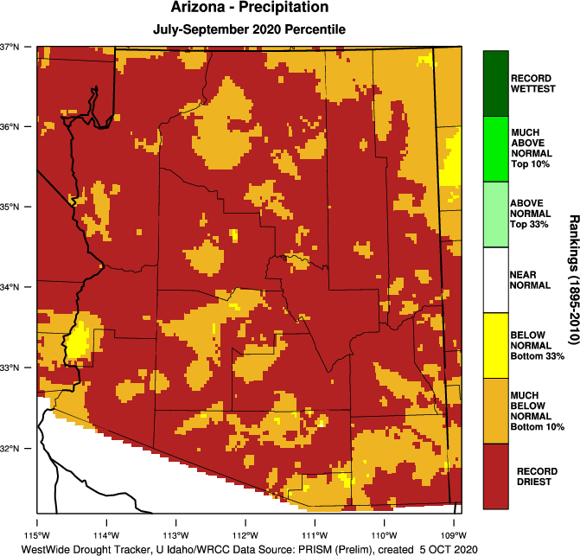
Water Year 2020 – Summer
Temperature
Precipitation
Source: Abatzoglou, J.T., D.J. McEvoy, and K.T. Redmond, in press, The West Wide Drought Tracker: Drought Monitoring at Fine Spatial Scales, Bulletin of the American Meteorological Society
Notes:
Part of the reason why Water Year 2020 did not do as well as the previous WY was because of the record-breaking high summer temperatures and low precipitation.
This past monsoon, specifically July through September, represents the warmest on record for most of the state, this is shown by the red color on the map on the left. The orange color represents those much above normal temperatures (at the top 10 percentile) and these are places that almost broke temperature records as well.
It was also the record driest monsoon for most of Arizona, as you can see the red color on the right-side map. It was almost record driest for the orange places on the map.
This was quite significant, and we will see how drought conditions were impacted by these trends.

Slide 18
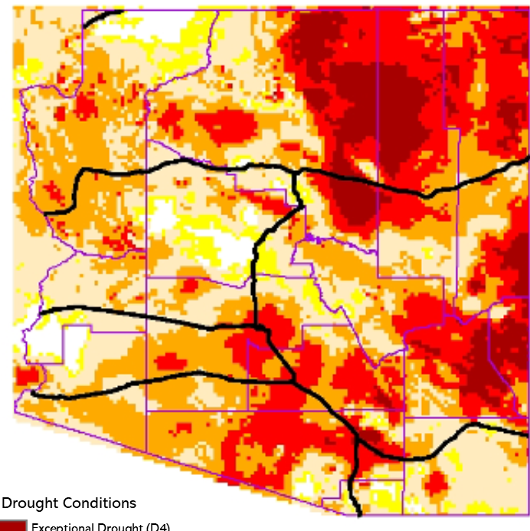
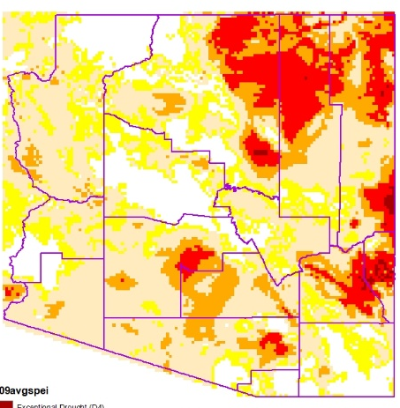
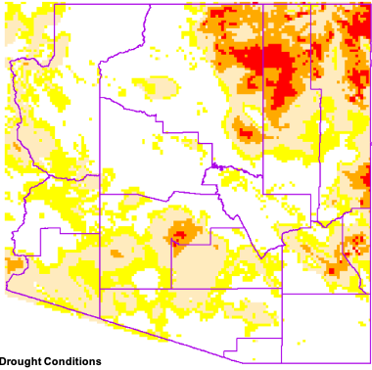
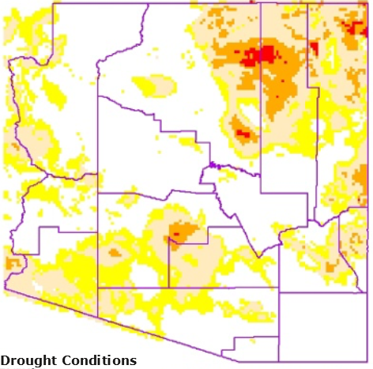

Long-Term
Drought Status Maps
Calendar Year 2020
Oct-Dec 2020
Jul-Sep 2020
Apr-Jun 2020
Jan-Mar 2020
Drought Conditions
None
D0 - Abnormally Dry
D1 - Moderate Drought
D2 - Severe Drought
D3 - Extreme Drought
D4 - Exceptional Drought
Notes:
This slide shows long-term drought maps that are developed by the State Climatologist on a quarterly basis.
They are based on averages of 24-, 36-, and 48-month (2, 3 and 4-year long-term averages) Standard Precipitation Indices or SPI and Standard Precipitation & Evapotranspiration Indices or SPEI.
On these we can see how the year had a great start, in terms of long-term drought, as we had a lot of good winter precipitation that reduced drought into the spring. This precipitation led to the filling of reservoirs throughout the Lower Colorado River Basin and the Salt & Verde River Reservoirs.
Only some northeastern parts of Arizona were under Severe (D2) to Extreme (D3) Drought and there were also areas with abnormally dry (D0) conditions throughout the state, represented by the yellow on the maps.
The hot and dry summer contributed to an increase in drought conditions throughout the entire state, as can be seen on the two top right maps on the slide that start to get bright red and dark red for Extreme and Exceptional Drought. These increased drought conditions had the potential to increase the need for groundwater use and irrigation throughout Arizona, which in turn can increase pressure on the state’s water supplies.

Slide 19
Percent of Average Precipitation
Water Year 2021 to date
Notes:
This map represents the Percent of Average Precipitation for Water Year 2021 to December 31, 2020 and it shows how most of the state was under 50% of the average precipitation that is typically received in Arizona during this period. There was, however, some precipitation in the form of snow in Navajo Nation recently, at the northeastern corner of Apache County, throughout the Chuska Mountains.

Slide 20
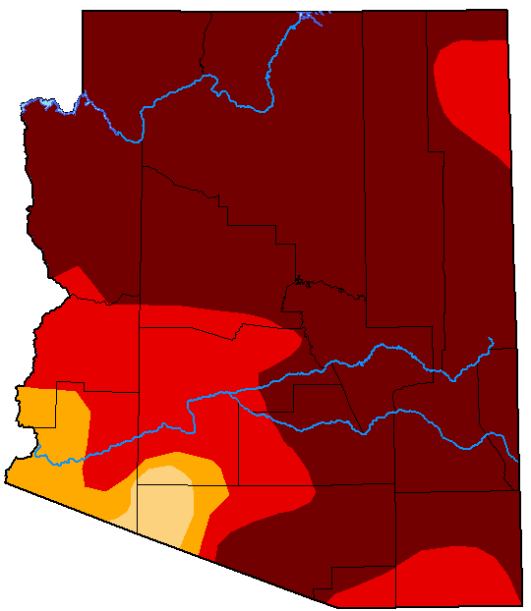
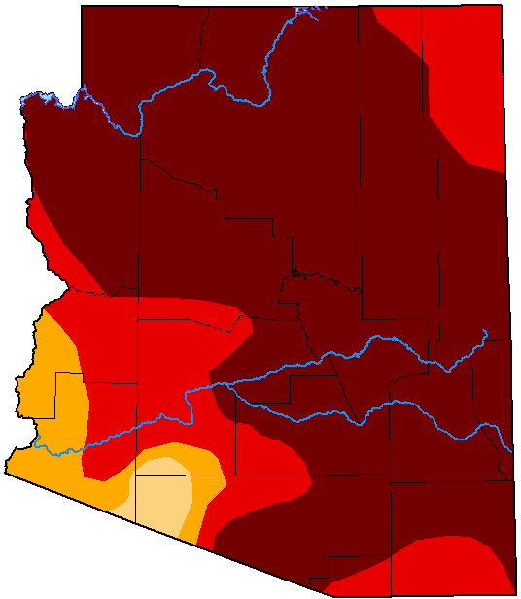
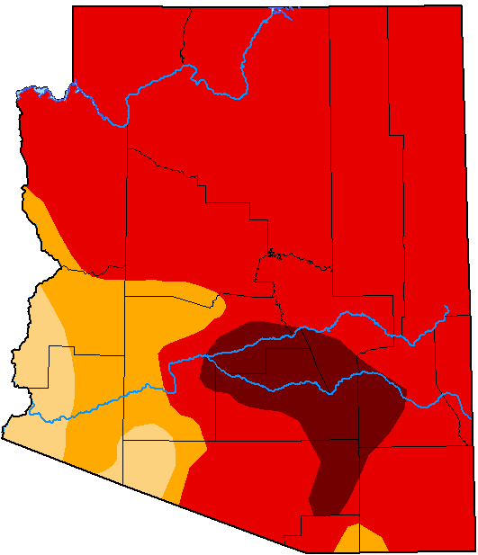
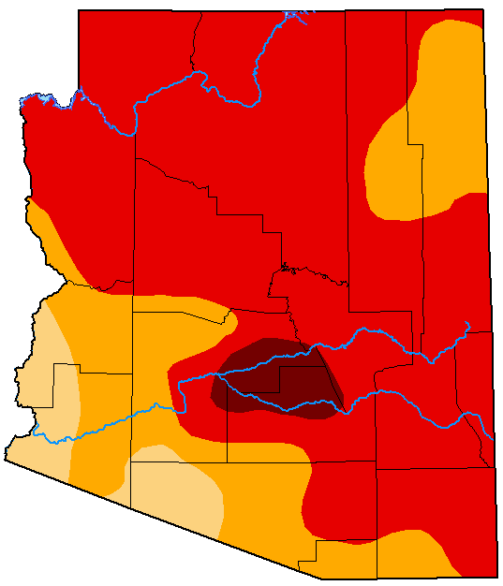
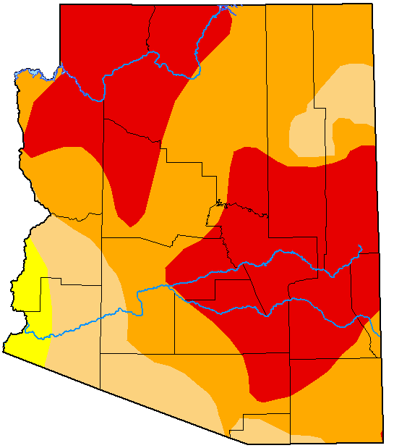



December
Short-Term
Drought Status Maps
Past 5 Months
November
October
September
August
Drought Conditions
None
D0 - Abnormally Dry
D1 - Moderate Drought
D2 - Severe Drought
D3 - Extreme Drought
D4 - Exceptional Drought
Notes:
These are short-term drought status maps for the past 5 weeks, these are developed on a weekly basis by the US Drought Monitor; the difference between short & long-term drought status maps is that while long-term are based on 2, 3 and 4-year long average SPI or SPEIs, the short-term maps use the average SPI and SPEI, among other information, from the previous 4 weeks.
July is not on the slide, but it was one of the hottest and driest months of July on record for Arizona and much of the Southwest.
The monsoon was pretty much non-existing last year and that led to an increase in drought conditions, as you can see the colors going from cream and orange, which represent Moderate and Severe Drought, to red, which es Extreme Drought and then dark red or maroon, which is Exceptional Drought.
While the fall and early winter continued the dry conditions trend that started even before the summer of 2020, there was some beneficial precipitation last week.

Slide 21
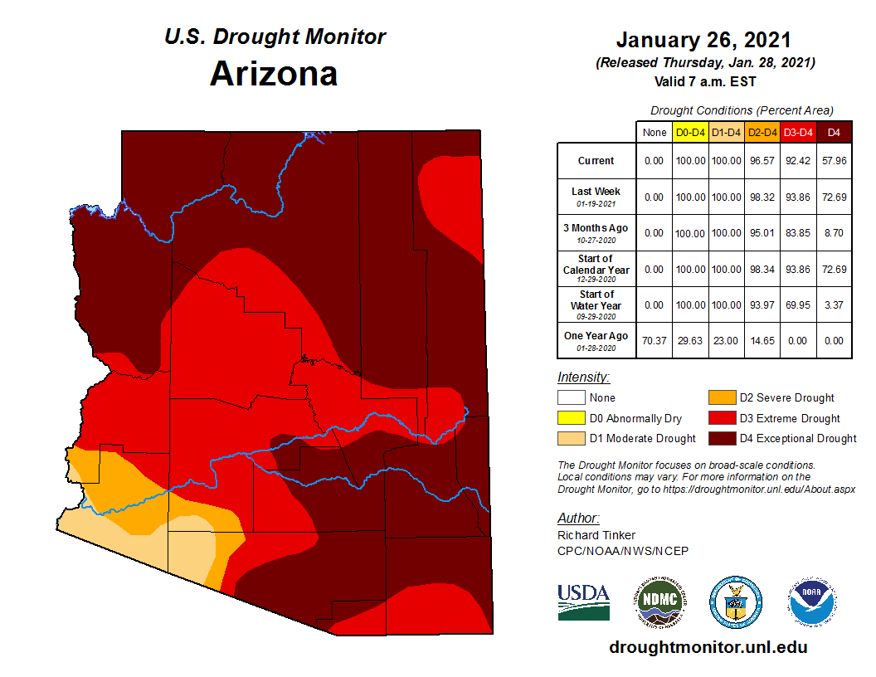
January 2021
Monthly
Short-Term Drought Status
Notes:
Right now, as of January 26, 2021, this is what short-term drought looks like:
The most recent storms that passed through the state improved conditions in central AZ particularly along the Mogollon Rim.
Exceptional Drought (represented by the dark red or maroon color), covered about 73% of the state at the end of December, and now covers 58% - that was a good improvement.
And Moderate and Severe Drought (represented by the cream and orange colors and the southwestern corner of Arizona) cover 3% and 4% of the state, respectively, this can be seen on the southwestern corner of the state.
While there were some improvements, Extreme Drought still covers about 35% of the state, compared to 21% at the end of December (this is represented by the bright red color).
On the map, Santa Cruz is shown to be currently under Extreme Drought and some northern parts of the County are under Exceptional Drought, these conditions may result in crop or pasture losses and water shortages, according to the US Drought Monitor.

Slide 22
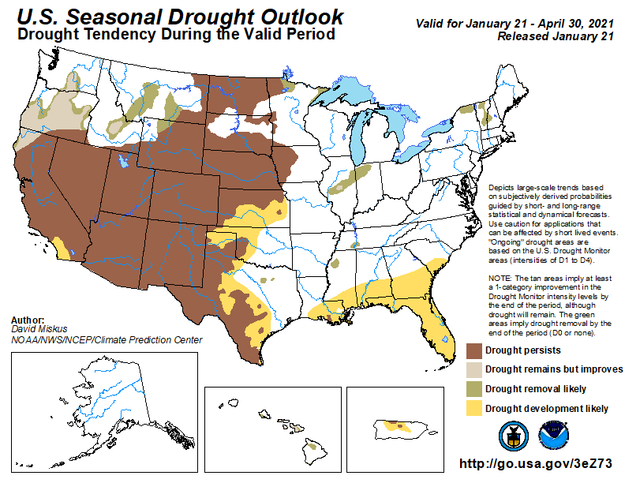
Notes:
This slide presents NOAA’s US Seasonal Drought Outlook, which indicates that drought is likely to persist in Arizona through April 30, 2021.
Most southwestern states throughout the Colorado River Basin are also brown, indicating the persistence of drought throughout into Spring.

Slide 23
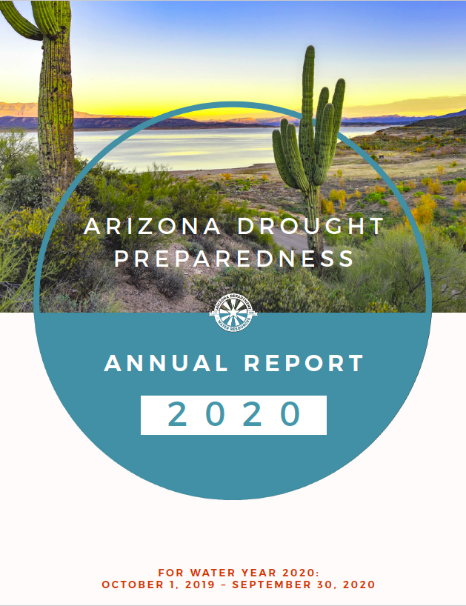
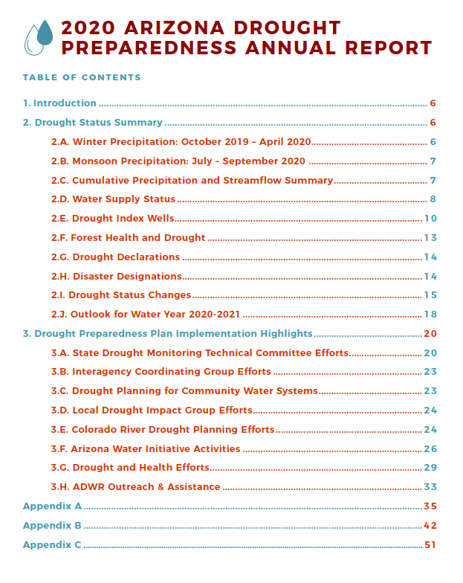
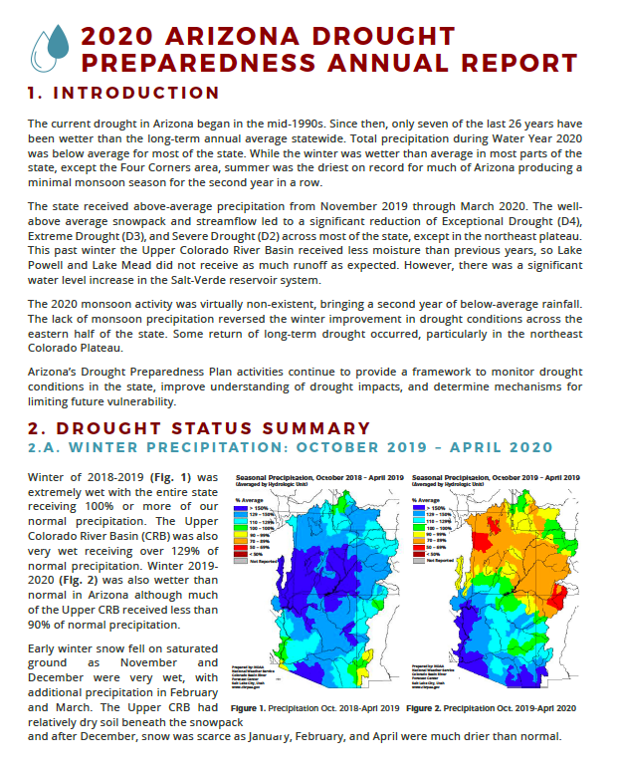
2020 Arizona Drought Preparedness Annual Report
The Arizona Drought Preparedness Annual Report covers drought conditions and preparedness activities for the water year (October 1 - September 30)
Notes:
And this is some information for those interested:
ADWR is required to submit an annual drought report to the Governor’s office by the end of the fiscal year for the previous water year.
The 2020 Drought Report covers the drought conditions and preparedness activities for the 2020 water year (Oct. 1, 2019 - Sep.30, 2020).
It includes:
Summary of Arizona’s drought status this past water-year and outlook for the next water-year
Drought designation information
Highlights of drought conditions and preparedness activities:
Water supply
The State’s Drought Monitoring Technical Committee and Interagency Coordinating Group efforts
Drought planning for community water systems
Local Drought Impact Groups activities
Outreach, education, participation in regional and national efforts, and assistance
The 2020 report is currently published on the ADWR Drought webpage

Slide 24
Thank you!
Némesis Ortiz-Declet
nortizdeclet@azwater.gov
Drought & Conservation Coordinator
Arizona Department of Water Resources

Slide 25
Meeting Agenda
Call to Order - Chair
Webinar Logistics – Kennedy Shepard, ADWR
ADWR Current Activities – Kyle Miller, ADWR
  Kyle will provide an update on agency activities
Arizona Drought Status Update – Nemesis Ortiz-Declet, ADWR
  Nemesis will provide an update on drought conditions in Arizona
WMAP Updates – Melissa Sikes, ADWR
  Melissa will provide an update on WMAP activities
Management Plans Update- Amanda Long, ADWR
  Amanda will provide updates on the 5th Management Plan Workgroups and subgroups activities
Call to Council - Council
Call to Public - Chair
Adjournment - Chair

Slide 26
Meeting Agenda
Call to Order - Chair
Webinar Logistics – Kennedy Shepard, ADWR
ADWR Current Activities – Kyle Miller, ADWR
  Kyle will provide an update on agency activities
Arizona Drought Status Update – Nemesis Ortiz-Declet, ADWR
  Nemesis will provide an update on drought conditions in Arizona
WMAP Updates – Melissa Sikes, ADWR
  Melissa will provide an update on WMAP activities
Management Plans Update- Amanda Long, ADWR
  Amanda will provide updates on the 5th Management Plan Workgroups and subgroups activities
Call to Council - Council
Call to Public - Chair
Adjournment - Chair

Slide 27
Management Plans Update
Santa Cruz AMA GUAC Meeting
February 3, 2021
Amanda Long
Management Plans Program Coordinator

Slide 28
Fourth Management Plans

Slide 29
4MP Adoption Timeline
1. Initial Draft Published
2. GUAC and Public Comments
3. Updated Draft Published
4. Public Hearing
5. Final Adoption
Phoenix AMA
Santa Cruz AMA
Pinal AMA
Programs Effective 1/1/2023
Final Adoption (est Summer 2021)
Programs Effective 1/1/2024
Final Adoption (est Winter 2020)
Final Adoption (est Summer 2020)
Programs Effective 1/1/2023
  Final Adoption: Spring 2020
  Programs Effective: January 2023
  Final Adoption:
  Fall 2020
  Programs Effective: January 2023
  Final Adoption:
  Winter 2020
  Programs Effective: January 2023
Conservation Program Requirements go into effect at least 2 years after a plan is adopted.
ADWR shifts the actual effective date past the 2 year mark to line up with Reporting Years.

Slide 30
Fifth Management Plans

Slide 31
Estimated 5MP Timeline new.azwater.gov/5MP
MPWG
Program Analysis
Program Development
Drafting
Document Structure & Content
Promulgation
Present to GUACs and stakeholders
Conservation Programs become effective 1/1/2025
Implementation & Strategy
2020
2021
2022
Notes:
Structure: Chapters, level of detail, projections

Slide 32
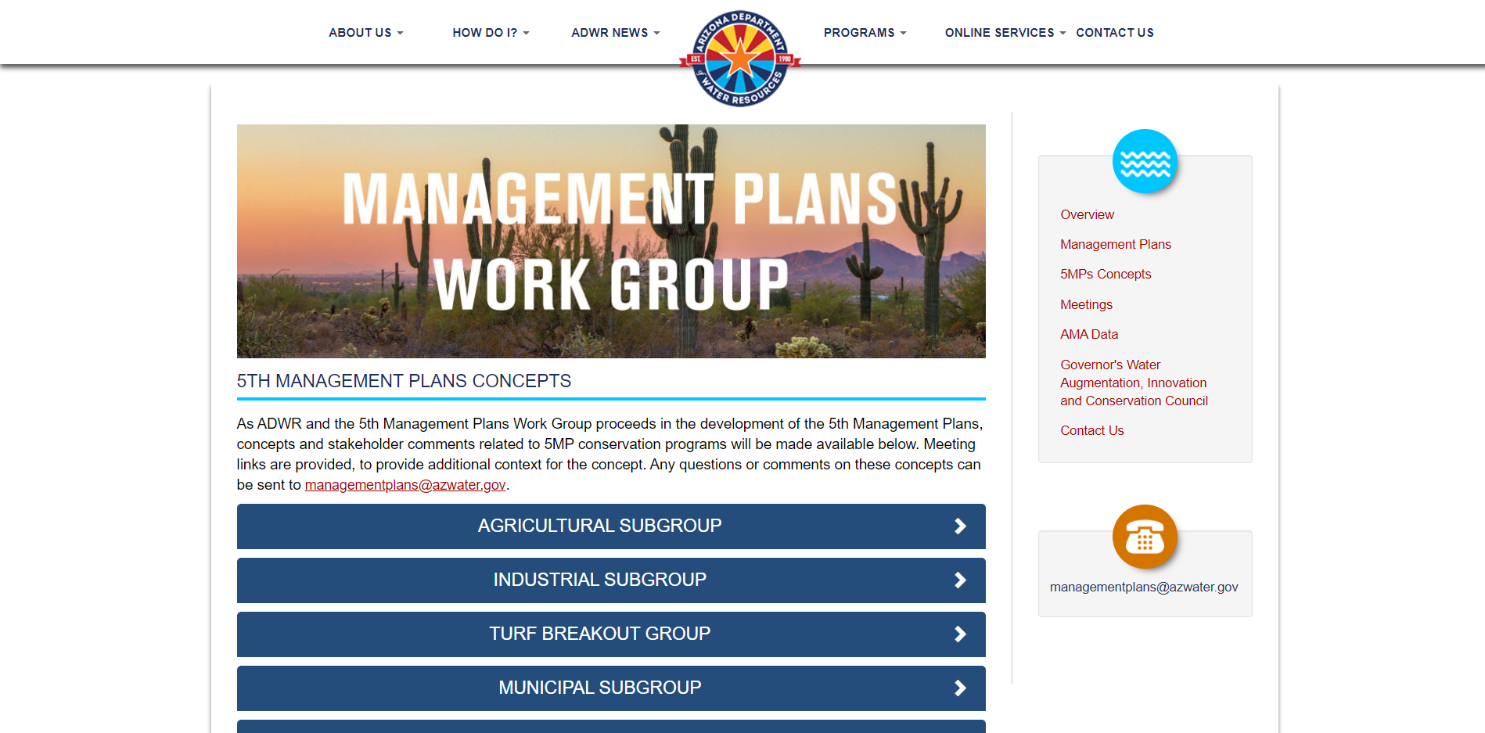
5MP Concepts Webpage
https://new.azwater.gov/5MP/plans-concepts
Notes:
Remove?

Slide 33
Drafting Logistics
All 5 Fifth Management Plans will be drafted simultaneously
  Structure will largely match across AMAs
  Time for AMA Customization
MPWG Subgroups will reconvene as needed to review draft regulatory language
Goal: Publication of Initial Drafts in early 2022

Slide 34

MPWG Subgroups
{ All meeting info is available at new.azwater.gov/5MP }
MPWG
Ag
Industrial
Turf
Work Group
Subgroup
Breakout
Muni
Safe-Yield Technical
TBD
3/24/2021
2/10/2021
TBD
3/10/2021
2/24/2021

Slide 35
Questions?
Amanda Long
along@azwater.gov
Management Plans Work Group:
new.azwater.gov/5MP
Concepts page: https://new.azwater.gov/5MP/plans-concepts
Full Text of Management Plans:
new.azwater.gov/ama/management-plans
For questions about meetings or to submit comments:
managementplans@azwater.gov

Slide 36
Meeting Agenda
Call to Order - Chair
Webinar Logistics – Kennedy Shepard, ADWR
ADWR Current Activities – Kyle Miller, ADWR
  Kyle will provide an update on agency activities
Arizona Drought Status Update – Nemesis Ortiz-Declet, ADWR
  Nemesis will provide an update on drought conditions in Arizona
WMAP Updates – Melissa Sikes, ADWR
  Melissa will provide an update on WMAP activities
Management Plans Update- Amanda Long, ADWR
  Amanda will provide updates on the 5th Management Plan Workgroups and subgroups activities
Call to Council - Council
Call to Public - Chair
Adjournment - Chair

Slide 37
Meeting Agenda
Call to Order - Chair
Webinar Logistics – Kennedy Shepard, ADWR
ADWR Current Activities – Kyle Miller, ADWR
  Kyle will provide an update on agency activities
Arizona Drought Status Update – Nemesis Ortiz-Declet, ADWR
  Nemesis will provide an update on drought conditions in Arizona
WMAP Updates – Melissa Sikes, ADWR
  Melissa will provide an update on WMAP activities
Management Plans Update- Amanda Long, ADWR
  Amanda will provide updates on the 5th Management Plan Workgroups and subgroups activities
Call to Council - Council
Call to Public - Chair
Adjournment - Chair

Slide 38
Meeting Agenda
Call to Order - Chair
Webinar Logistics – Kennedy Shepard, ADWR
ADWR Current Activities – Kyle Miller, ADWR
  Kyle will provide an update on agency activities
Arizona Drought Status Update – Nemesis Ortiz-Declet, ADWR
  Nemesis will provide an update on drought conditions in Arizona
WMAP Updates – Melissa Sikes, ADWR
  Melissa will provide an update on WMAP activities
Management Plans Update- Amanda Long, ADWR
  Amanda will provide updates on the 5th Management Plan Workgroups and subgroups activities
Call to Council - Council
Call to Public - Chair
Adjournment - Chair

