Slide 1

Phoenix GUAC Meeting
February 4, 2021

Slide 2
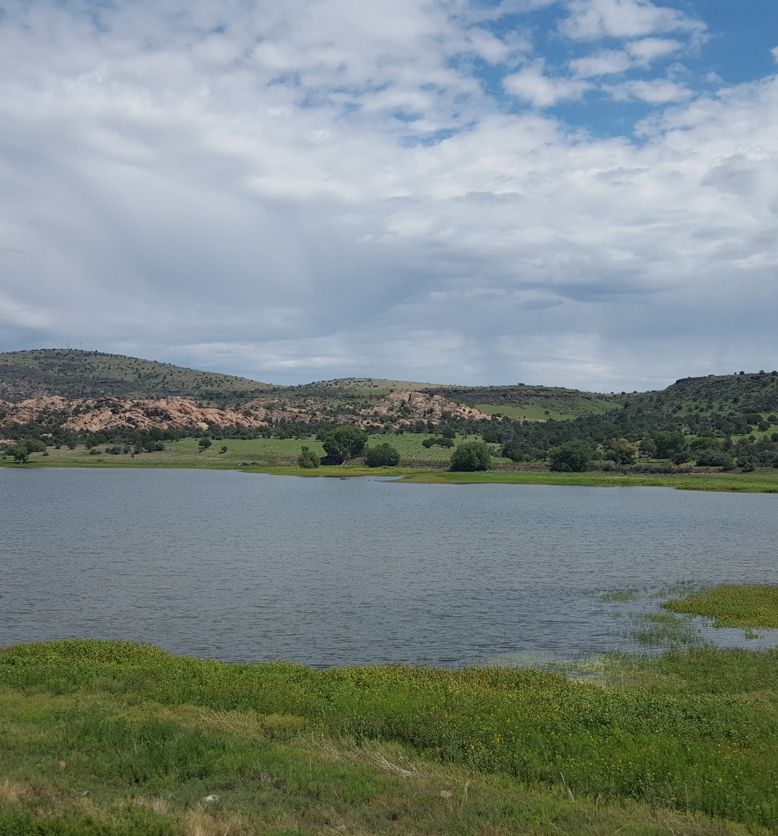
AMA Annual Reports
Non-exempt wells (>35 gpm) inside AMAs and INAs must meter well pumpage.
Users subject to reporting requirements must submit Annual Water Withdrawal and Use Reports –
    Due March 31st each year
  Volume of groundwater pumped by well
  Report movement of water
    Types and Volumes of Water Delivered/Received
    Types and Volumes of Water Stored/Recovered
    Generation/Discharge of Effluent
  May report types of end use
  Additional information related to conservation requirements or any other information the director deems necessary
Notes:
ARS 45-632(M) The director may require such other information in the report as may be necessary to accomplish the management goals of the applicable active management area.

Slide 3
ADWR Data Compilation
AMA Data
Prescott AMA
Santa Cruz AMA
Ag
Muni
Industrial
Tribal (estimated)
Tucson AMA
Phoenix AMA
Pinal AMA
Muni
Ag
Ag
Muni
Industrial
Tribal (estimated)
Ag
Muni
Industrial
Tribal (estimated)
Ag
Muni
Industrial
Statewide Water Use Estimates
Bureau of Reclamation
USGS
Recharge
Recharge
Recharge
Recharge
Recharge
Ind
Compiled AMA data is available at new.azwater.gov/ama/ama-data
Statewide Water Use information is available at www.arizonawaterfacts.com

Slide 4
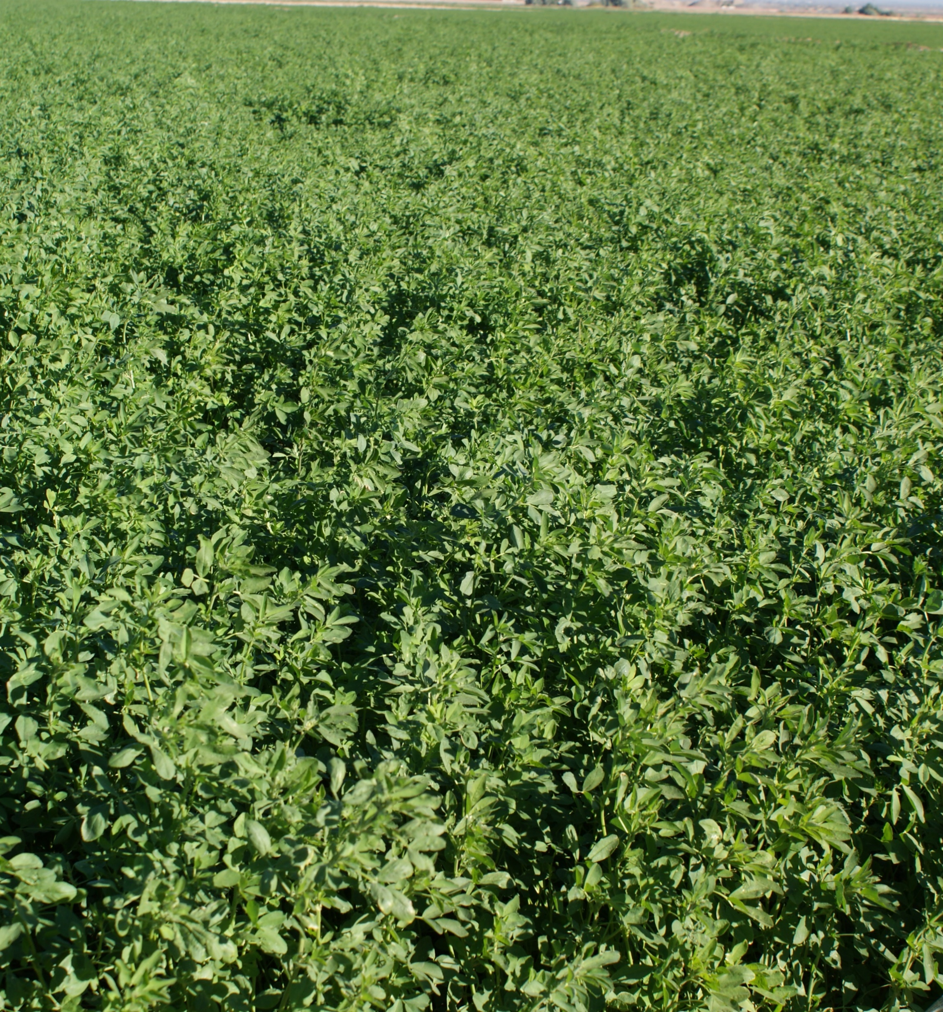
Other Data
ADWR Estimates
  Tribal water use inside the AMAs
  Exempt well water use inside the AMAs
Bureau of Reclamation
  Colorado River Diversions and Consumptive Use
  Contributions to Lake Mead
USGS
  Water Use Estimates outside the AMAs
US Census
US Bureau of Economic Analysis

Slide 5
Statewide Demand

Slide 6
Statewide Supply

Slide 7
Phoenix AMA
https://new.azwater.gov/ama/ama-data
2,248,120 AF

Slide 8
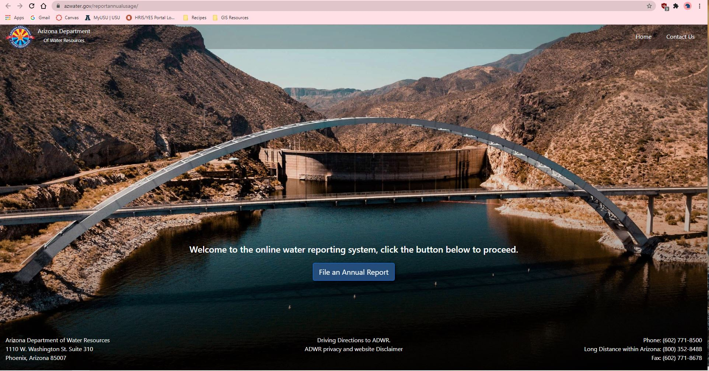
https://www.azwater.gov/reportannualusage/

