Slide 1

Welcome
Please keep your phone muted during the meeting.
Type your question/comment in the chat box and it will be read and addressed at the end of each presentation
During the Call to Public people will have the option to speak to the Council.
With any technical difficulties please contact ADWR Help Desk at 602-771-8444 or tickets@azwater.gov

Slide 2

Prescott AMA GUAC September 25, 2023

Slide 3
Meeting Agenda
Call to Order – Welcome & Introductions - Chair
Meeting Logistics – Joy Arevalo Vera, ADWR
Groundwater Withdrawal Fee Recommendation & WMAP
a. Review withdrawal fee rates and money collected in past five years, WMAP projects,
and remaining balance – Melissa Sikes, ADWR
b. Discuss and recommend to ADWR Director groundwater withdrawal fee rates for reporting year 2024 – Council
The Council will hear the current status of the WMAP fund and discuss and recommend
the withdrawal fee rate for the upcoming reporting year
WMAP Completed Project Presentation
a. City of Prescott’s Conservation Webpage Redesign – Kay Sydow, City of Prescott
AMA Director Report– Natalie Mast, ADWR
Natalie will provide an update on ADWR activities, including staffing,
water supply & demand analyses, and the Governor’s Water Policy Council
Call to the Council – Council
Call to the Public – Chair
Adjournment – Chair

Slide 4
Meeting Agenda
Call to Order – Welcome & Introductions - Chair
Meeting Logistics – Joy Arevalo Vera, ADWR
Groundwater Withdrawal Fee Recommendation & WMAP
a. Review withdrawal fee rates and money collected in past five years, WMAP projects,
and remaining balance – Melissa Sikes, ADWR
b. Discuss and recommend to ADWR Director groundwater withdrawal fee rates for reporting year 2024 – Council
The Council will hear the current status of the WMAP fund and discuss and recommend
the withdrawal fee rate for the upcoming reporting year
WMAP Completed Project Presentation
a. City of Prescott’s Conservation Webpage Redesign – Kay Sydow, City of Prescott
AMA Director Report– Natalie Mast, ADWR
Natalie will provide an update on ADWR activities, including staffing,
water supply & demand analyses, and the Governor’s Water Policy Council
Call to the Council – Council
Call to the Public – Chair
Adjournment – Chair

Slide 5
Meeting Logistics
For guests joining online:
  Please keep your phone muted during the meeting.
  Type your question/comment in the chat box and it will be read and addressed during the Call to Public
During the Call to Public people will have the option to speak to the Council.
This meeting is being recording and will be posted to ADWR’s website.
With any technical difficulties please contact ADWR Help Desk at 602-771-8444 or tickets@azwater.gov

Slide 6
Meeting Agenda
Call to Order – Welcome & Introductions - Chair
Meeting Logistics – Joy Arevalo Vera, ADWR
Groundwater Withdrawal Fee Recommendation & WMAP
a. Review withdrawal fee rates and money collected in past five years, WMAP projects,
and remaining balance – Melissa Sikes, ADWR
b. Discuss and recommend to ADWR Director groundwater withdrawal fee rates for reporting year 2024 – Council
The Council will hear the current status of the WMAP fund and discuss and recommend
the withdrawal fee rate for the upcoming reporting year
WMAP Completed Project Presentation
a. City of Prescott’s Conservation Webpage Redesign – Kay Sydow, City of Prescott
AMA Director Report– Natalie Mast, ADWR
Natalie will provide an update on ADWR activities, including staffing,
water supply & demand analyses, and the Governor’s Water Policy Council
Call to the Council – Council
Call to the Public – Chair
Adjournment – Chair

Slide 7
Withdrawal Fees Information
Year |  | 2018 | 2019 | 2020 | 2021 | 2022 | 2023 | 2024
WMAP | Fee | $1.00 | $1.00 | $1.00 | $1.25 | $1.25 | $1.25 | Max $2.00
 | Collected | $15,950 | $12,482 | $13,803 | $17,329 | $13,971 | N/A
Administration & Enforcement | Fee | $1.00 | $1.00 | $1.00 | $0.75 | $0.75 | $0.75 | Min. $0.50 Max. $1.00
 | Collected | $15,950 | $12,482 | $13,803 | $10,720 | $8,382 | N/A
Total | Fee | $2.00 | $2.00 | $2.00 | $2.00 | $2.00 | $2.00 | TBD
 | Collected* | $34,481 | $26,825 | $30,828 | $31,521 | $24,930 | N/A
* In addition to WMAP and Admin & Enforcement, amount includes late fees, Recovery Wells fee, and Water Quality Fund

Slide 8
Water Management Assistance Program Fund
Current Balance: $112,183
Encumbered/committed: $9,570 Remaining Balance: $102,613
Water Management Assistance Program Project
PROJECT NAME | DESCRIPTION | CONTRACT NUMBER | TOTAL FUNDING | REMAININGFUNDING | CONTRACT ENDS
Conservation Webpage Redesign | Funds will be used to redesign the water conservation webpage on the City of Prescott website. | 2022-3150 IGA | $10,000 | $0 | 8/30/2023
Groundwater Conservation Grant Projects
PROJECT NAME | DESCRIPTION | CONTRACT NUMBER | WMAP FUNDS | TOTAL FUNDING | CONTRACT ENDS
Town of Prescott Valley Water Smart Customer Portal | Utilize Water Smart computer software to provide real-time leak alerts and connect water customers to their current and historic water use record. | 2020-3127 IGA | - | $77,313 | 11/30/2023
Rainwater Harvesting for Aquifer Recharge | Install a rainwater harvesting system to capture water from roof structures and recharge the aquifer. | 2020-3128 | - | $65,131 | 12/31/2024
SR 89 Stormwater Recharge Pilot Project | Pilot study to examine feasibility of connecting stormwater detention basins to collect and divert storm water flow from SR 89 to the aquifer through dry wells. | 2020-3119 IGA | $67,444 | $75,000 | 12/31/2024

Slide 9
Meeting Agenda
Call to Order – Welcome & Introductions - Chair
Meeting Logistics – Joy Arevalo Vera, ADWR
Groundwater Withdrawal Fee Recommendation & WMAP
a. Review withdrawal fee rates and money collected in past five years, WMAP projects,
and remaining balance – Melissa Sikes, ADWR
b. Discuss and recommend to ADWR Director groundwater withdrawal fee rates for reporting year 2024 – Council
The Council will hear the current status of the WMAP fund and discuss and recommend
the withdrawal fee rate for the upcoming reporting year
WMAP Completed Project Presentation
a. City of Prescott’s Conservation Webpage Redesign – Kay Sydow, City of Prescott
AMA Director Report– Natalie Mast, ADWR
Natalie will provide an update on ADWR activities, including staffing,
water supply & demand analyses, and the Governor’s Water Policy Council
Call to the Council – Council
Call to the Public – Chair
Adjournment – Chair

Slide 10
Withdrawal Fees Information
Year |  | 2018 | 2019 | 2020 | 2021 | 2022 | 2023 | 2024
WMAP | Fee | $1.00 | $1.00 | $1.00 | $1.25 | $1.25 | $1.25 | Max $2.00
 | Collected | $15,950 | $12,482 | $13,803 | $17,329 | $13,971 | N/A
Administration & Enforcement | Fee | $1.00 | $1.00 | $1.00 | $0.75 | $0.75 | $0.75 | Min. $0.50 Max. $1.00
 | Collected | $15,950 | $12,482 | $13,803 | $10,720 | $8,382 | N/A
Total | Fee | $2.00 | $2.00 | $2.00 | $2.00 | $2.00 | $2.00 | TBD
 | Collected* | $34,481 | $26,825 | $30,828 | $31,521 | $24,930 | N/A
* In addition to WMAP and Admin & Enforcement, amount includes late fees, Recovery Wells fee, and Water Quality Fund

Slide 11
Meeting Agenda
Call to Order – Welcome & Introductions - Chair
Meeting Logistics – Joy Arevalo Vera, ADWR
Groundwater Withdrawal Fee Recommendation & WMAP
a. Review withdrawal fee rates and money collected in past five years, WMAP projects,
and remaining balance – Melissa Sikes, ADWR
b. Discuss and recommend to ADWR Director groundwater withdrawal fee rates for reporting year 2024 – Council
The Council will hear the current status of the WMAP fund and discuss and recommend
the withdrawal fee rate for the upcoming reporting year
WMAP Completed Project Presentation
a. City of Prescott’s Conservation Webpage Redesign – Kay Sydow, City of Prescott
AMA Director Report– Natalie Mast, ADWR
Natalie will provide an update on ADWR activities, including staffing,
water supply & demand analyses, and the Governor’s Water Policy Council
Call to the Council – Council
Call to the Public – Chair
Adjournment – Chair

Slide 12

Groundwater Users
Advisory Council
Water Management
Assistance Program
(WMAP)
September 25, 2023

Slide 13



Project Tasks
Hire a Professional Webpage Designer
Weekly or Monthly Communication with the Designer
Finalize the Design
Outreach

Slide 14
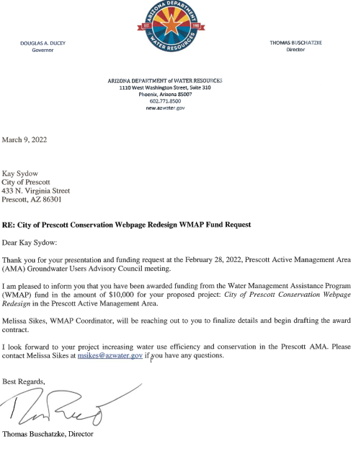
Webpage Redesign
March 9, 2022
Director Buschatzke awards
$10,000 grant (with a City match)
for
City of Prescott Conservation Webpage Redesign
In the Prescott Active Management Area

Slide 15
Webpage Redesign
Task 1
Task 2
Hire a Professional Webpage Designer
Deliverable: Design Plan
$2500.00
Sadie Sarti Design Company
Hired in April 2022
To Stay in Weekly or Monthly Communication with the Designer
Deliverable: Design Progress Report
$2500.00
All webpage content was provided, and Sadie Sarti Design Company rearranged the design to a very pleasing effect

Slide 16



Webpage Redesign
Webpage Design Elements
Conservation: Outdoor, Indoor and Tools
Drought
Education & Activities
BLOG
Calendar of Events
Rebates and Incentives

Slide 17

Home Page
Scrolling down, there are links to all the other webpages

Slide 18

Outdoor Water Conservation

Slide 19
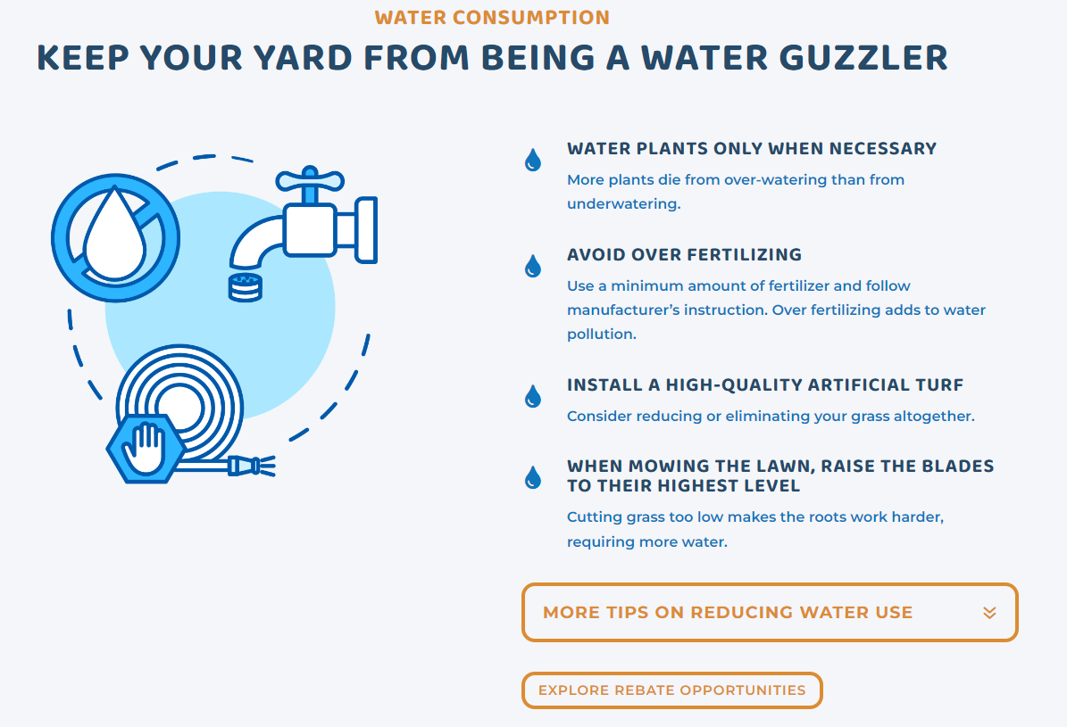
Outdoor Water Conservation
Each page has a link to “Explore Rebate Opportunities”

Slide 20

Indoor Water Conservation

Slide 21
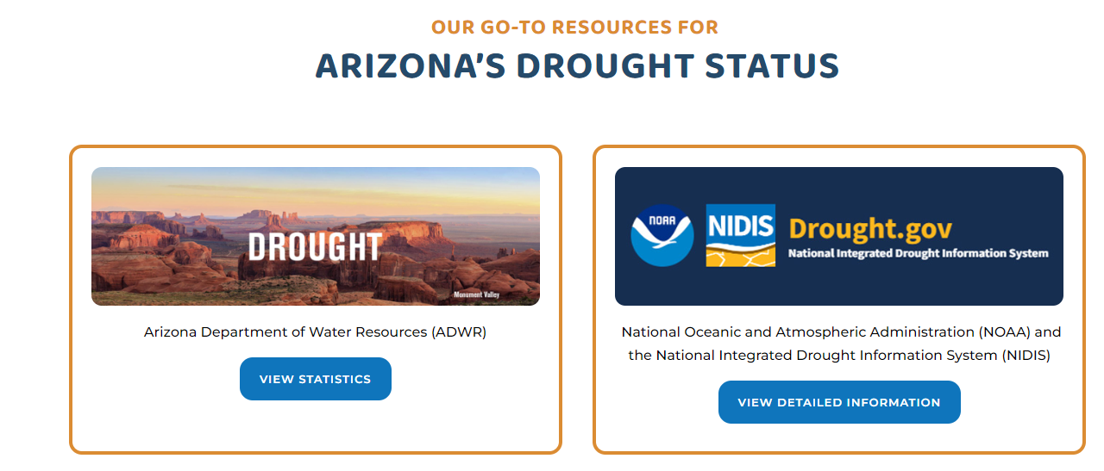
Drought Preparedness

Slide 22

Education & Activities

Slide 23
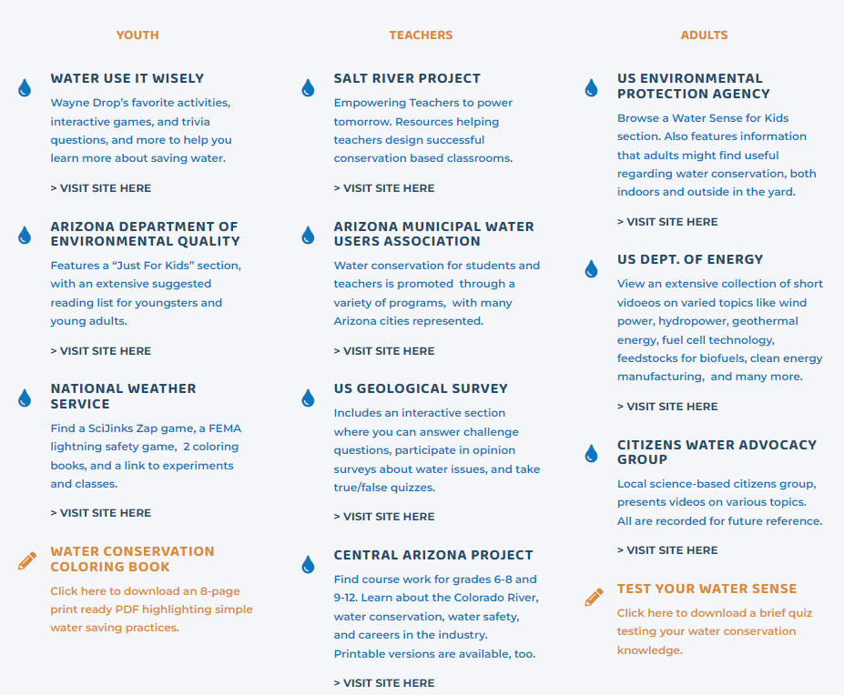
Education & Activities
Resources for Kids, Teachers, & Adults

Slide 24
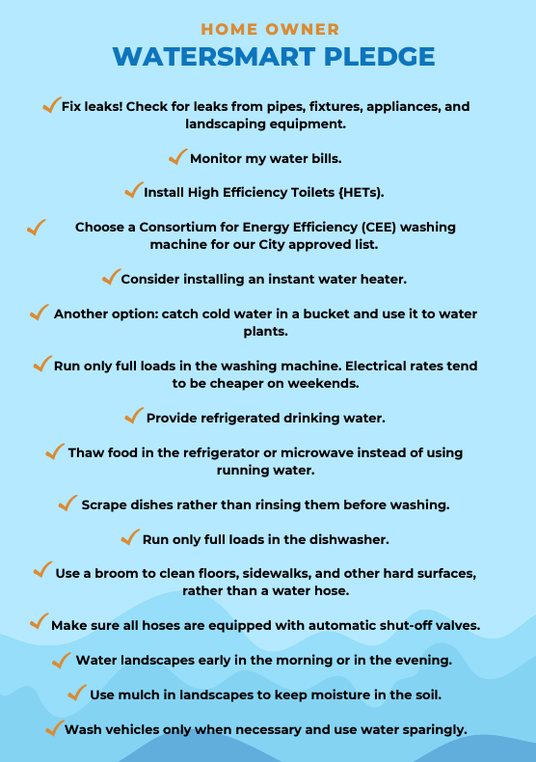
Education & Activities
Calling all homeowners
We created a printable pledge for you to post at home, at the office, or around the community. Remind yourself and other of the little practices that add up to massive water conservation efforts.

Slide 25

Rebates & Incentives
In August 2022, former Governor Bruce Babbitt said the City of Prescott has the best rebate program in the state.

Slide 26
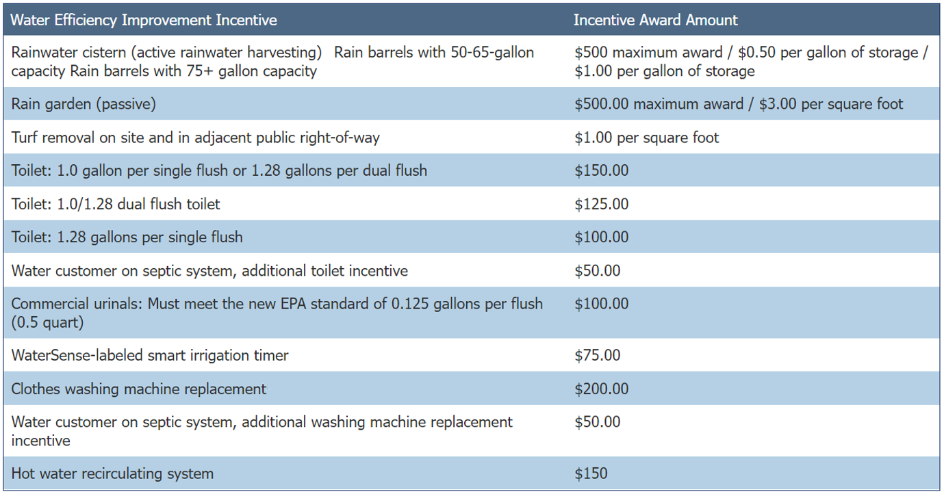
Rebates & Incentives

Slide 27
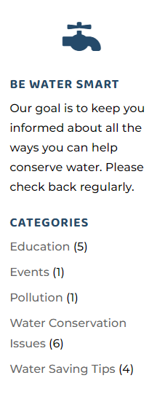
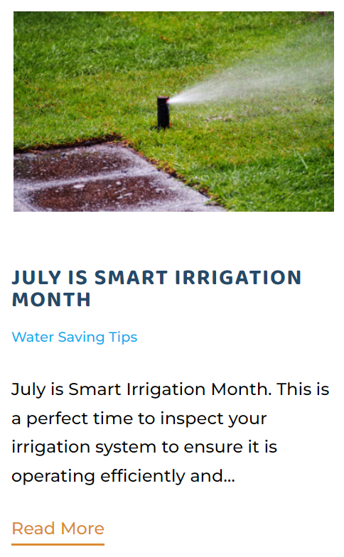


Conservation Blog

Slide 28
Webpage Redesign
Task 3
Task 4
Finalize the Design
Deliverable: Completed Webpage
$2500.00
Outreach
Deliverable: Public Awareness
Website Initiated
March 21, 2023
By June 29, 2023, there were 1500 views
Sadie Sartie Design Company
Final Payment: $1527
Total: $9027

Slide 29
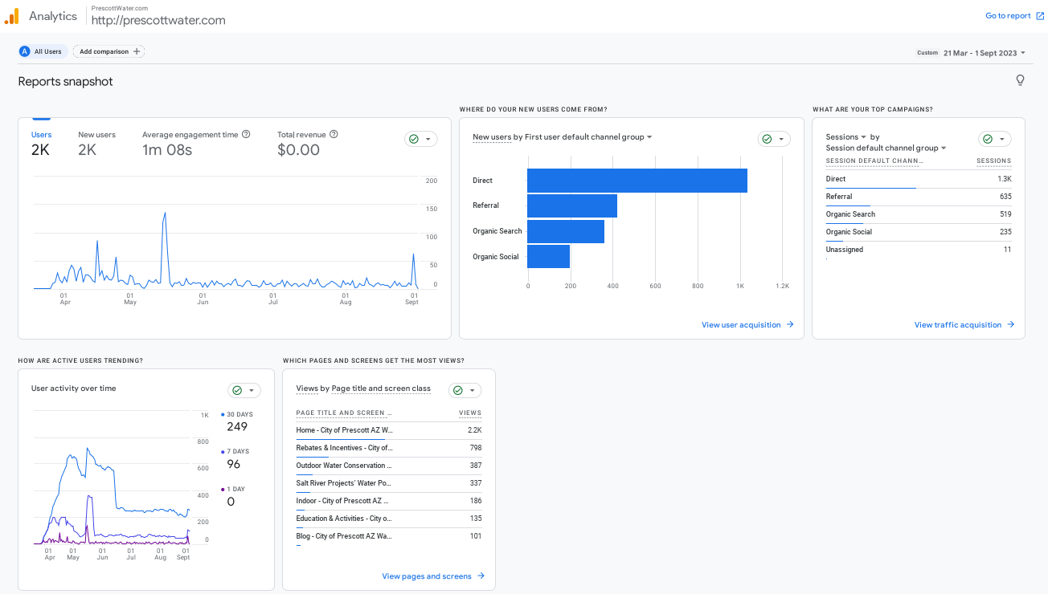
Webpage Redesign
Delivered Google Analytics

Slide 30


Webpage Redesign
Delivered to WMAP
Press Release
All BLOG Postings
Facebook and Instagram Posts

Slide 31

Thank You
Many thanks to:
Melissa Sikes, Coordinator for GUAC Grants
Thao Le, AMA Intern
and anyone else at ADWR who helped the City acquire the WMAP Grant!!!
We are truly grateful.
Be sure to check out the City’s new website
devoted entirely to water conservation!
prescottwater.com

Slide 32
Meeting Agenda
Call to Order – Welcome & Introductions - Chair
Meeting Logistics – Joy Arevalo Vera, ADWR
Groundwater Withdrawal Fee Recommendation & WMAP
a. Review withdrawal fee rates and money collected in past five years, WMAP projects,
and remaining balance – Melissa Sikes, ADWR
b. Discuss and recommend to ADWR Director groundwater withdrawal fee rates for reporting year 2024 – Council
The Council will hear the current status of the WMAP fund and discuss and recommend
the withdrawal fee rate for the upcoming reporting year
WMAP Completed Project Presentation
a. City of Prescott’s Conservation Webpage Redesign – Kay Sydow, City of Prescott
AMA Director Report– Natalie Mast, ADWR
Natalie will provide an update on ADWR activities, including staffing,
water supply & demand analyses, and the Governor’s Water Policy Council
Call to the Council – Council
Call to the Public – Chair
Adjournment – Chair

Slide 33
Meeting Agenda
Call to Order – Welcome & Introductions - Chair
Meeting Logistics – Joy Arevalo Vera, ADWR
Groundwater Withdrawal Fee Recommendation & WMAP
a. Review withdrawal fee rates and money collected in past five years, WMAP projects,
and remaining balance – Melissa Sikes, ADWR
b. Discuss and recommend to ADWR Director groundwater withdrawal fee rates for reporting year 2024 – Council
The Council will hear the current status of the WMAP fund and discuss and recommend
the withdrawal fee rate for the upcoming reporting year
WMAP Completed Project Presentation
a. City of Prescott’s Conservation Webpage Redesign – Kay Sydow, City of Prescott
AMA Director Report– Natalie Mast, ADWR
Natalie will provide an update on ADWR activities, including staffing,
water supply & demand analyses, and the Governor’s Water Policy Council
Call to the Council – Council
Call to the Public – Chair
Adjournment – Chair

Slide 34
Meeting Agenda
Call to Order – Welcome & Introductions - Chair
Meeting Logistics – Joy Arevalo Vera, ADWR
Groundwater Withdrawal Fee Recommendation & WMAP
a. Review withdrawal fee rates and money collected in past five years, WMAP projects,
and remaining balance – Melissa Sikes, ADWR
b. Discuss and recommend to ADWR Director groundwater withdrawal fee rates for reporting year 2024 – Council
The Council will hear the current status of the WMAP fund and discuss and recommend
the withdrawal fee rate for the upcoming reporting year
WMAP Completed Project Presentation
a. City of Prescott’s Conservation Webpage Redesign – Kay Sydow, City of Prescott
AMA Director Report– Natalie Mast, ADWR
Natalie will provide an update on ADWR activities, including staffing,
water supply & demand analyses, and the Governor’s Water Policy Council
Call to the Council – Council
Call to the Public – Chair
Adjournment – Chair

Slide 35
Meeting Agenda
Call to Order – Welcome & Introductions - Chair
Meeting Logistics – Joy Arevalo Vera, ADWR
Groundwater Withdrawal Fee Recommendation & WMAP
a. Review withdrawal fee rates and money collected in past five years, WMAP projects,
and remaining balance – Melissa Sikes, ADWR
b. Discuss and recommend to ADWR Director groundwater withdrawal fee rates for reporting year 2024 – Council
The Council will hear the current status of the WMAP fund and discuss and recommend
the withdrawal fee rate for the upcoming reporting year
WMAP Completed Project Presentation
a. City of Prescott’s Conservation Webpage Redesign – Kay Sydow, City of Prescott
AMA Director Report– Natalie Mast, ADWR
Natalie will provide an update on ADWR activities, including staffing,
water supply & demand analyses, and the Governor’s Water Policy Council
Call to the Council – Council
Call to the Public – Chair
Adjournment – Chair

